Slide 1

Welcome to our Parish Listening Session!
Notes:
This workshop is designed to familiarize pastors and parish coordinators with the Synod on Synodality and what that process may look like in your own parishes. You will learn that there are three ways to participate in our Archdiocese, however, this presentation is going to focus on the Parish Listening Sessions.

Slide 2
Parish Synod Listening Sessions
Opening Prayer
What is a Synod?
Emphasis on Prayer and Discernment
Ground Rules
Questions for Discussion and Listening
Summary

Slide 3
Synod Prayer
We stand before You, Holy Spirit, as we gather together in Your name.
With You alone to guide us, make Yourself at home in our hearts;
Teach us the way we must go and how we are to pursue it.
We are weak and sinful; do not let us promote disorder.
Do not let ignorance lead us down the wrong path
nor partiality influence our actions.
Let us find in You our unity so that we may journey together
to eternal life and not stray from the way of truth and what is right.
All this we ask of You, who are at work in every place and time, in the communion of the Father and the Son, forever and ever. Amen.

Slide 4
Lectio Divina – Divine Reading
Four steps/four R’s of Lectio Divina:
Reading (Lectio) Reading
Meditation (Meditatio) Reflecting
Praying (Oratio) Responding
Contemplation (Contemplatio) Remaining
Notes:
We’d like to begin with a brief time of reflection that touches on some of the themes of Synod. It is recommended when organizing your Synod Parish Listening Session that you also begin in prayer … perhaps a similar Lectio Divina activity. Lectio Divina is prayer with Holy Scripture, which allows us to quiet our minds and hearts to hear how the Holy Spirit is speaking to us with and through the text.
The 4 R’s
1) Read (Lectio): Read the Scripture passage through thoroughly. Take your time. Get a sense of what it is saying. Read the passage a second time. Listen for words or phrases that strike you, and listen in your heart.
2) Reflect (Meditatio): Read the passage again, slowly. Reflect upon what you have read. Ask yourself which word, which phrase, which passage speaks to you, challenges you, tugs at you this day. Which word or passage got your attention this day? Sit with these words and allow them to penetrate your spirit.
3) Respond (Oratio): Read the passage again slowly. How do you respond to the stirrings in your heart, your conscience? How does this passage challenge you to look upon the world? How does it effect your interactions with others? How does it change how you see yourself? God spoke to you; what is your response to God?
4) Receive (Contemplatio): Sit in the silence; sit in the Presence of God; receive what it is that God is giving you.

Slide 5
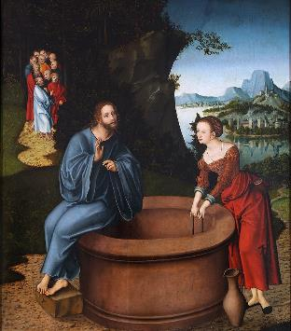
Lectio Divina (Jesus and the Woman at the Well)
John 4:5-30
Christ and the Samaritan Woman, Lucas Cranach the Elder
Notes:
A reading from John 4:
So he came to a Samaritan city called Sychar, near the plot of ground that Jacob had given to his son Joseph. Jacob’s well was there, and Jesus, tired out by his journey, was sitting by the well. It was about noon.
A Samaritan woman came to draw water, and Jesus said to her, “Give me a drink.” (His disciples had gone to the city to buy food.) The Samaritan woman said to him, “How is it that you, a Jew, ask a drink of me, a woman of Samaria?” (Jews do not share things in common with Samaritans.) Jesus answered her, “If you knew the gift of God, and who it is that is saying to you, ‘Give me a drink,’ you would have asked him, and he would have given you living water.” The woman said to him, “Sir, you have no bucket, and the well is deep. Where do you get that living water? Are you greater than our ancestor Jacob, who gave us the well, and with his sons and his flocks drank from it?” Jesus said to her, “Everyone who drinks of this water will be thirsty again, but those who drink of the water that I will give them will never be thirsty. The water that I will give will become in them a spring of water gushing up to eternal life.” The woman said to him, “Sir, give me this water, so that I may never be thirsty or have to keep coming here to draw water.”
Jesus said to her, “Go, call your husband, and come back.” The woman answered him, “I have no husband.” Jesus said to her, “You are right in saying, ‘I have no husband’; for you have had five husbands, and the one you have now is not your husband. What you have said is true!” The woman said to him, “Sir, I see that you are a prophet. Our ancestors worshiped on this mountain, but you say that the place where people must worship is in Jerusalem.” Jesus said to her, “Woman, believe me, the hour is coming when you will worship the Father neither on this mountain nor in Jerusalem. You worship what you do not know; we worship what we know, for salvation is from the Jews. But the hour is coming, and is now here, when the true worshipers will worship the Father in spirit and truth, for the Father seeks such as these to worship him. God is spirit, and those who worship him must worship in spirit and truth.” The woman said to him, “I know that Messiah is coming” (who is called Christ). “When he comes, he will proclaim all things to us.” Jesus said to her, “I am he, the one who is speaking to you.”
Just then his disciples came. They were astonished that he was speaking with a woman, but no one said, “What do you want?” or, “Why are you speaking with her?” Then the woman left her water jar and went back to the city. She said to the people, “Come and see a man who told me everything I have ever done! He cannot be the Messiah, can he?” They left the city and were on their way to him. John 4: 5-30

Slide 6
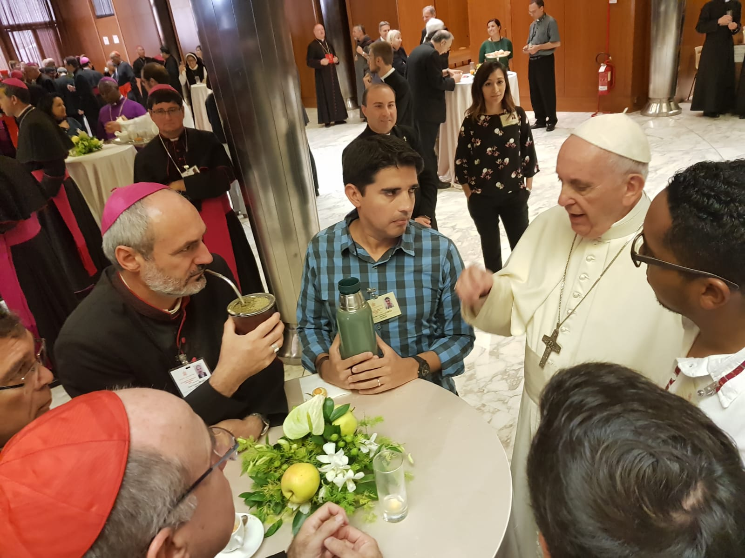
What is a Synod?
Synod = ‘the same way’
(From Greek Syn-hodos)
Usually a gathering of bishops
Focus on specific church issue
Notes:
The word Synod comes from Greek Syn-hodos which means “the same way”. Traditionally, a synod is a gathering of bishops who come together to focus on a specific issue in the Church.
In our modern era, following Vatican II, the practice of synods was renewed. Before bishops meet to discuss a particular concern, they are given several documents to read and pray through. Synods are therefore always rooted in listening to how the Holy Spirit is working through the Church both in the past and today.

Slide 7
What is a Synod?, cont’d.
This Synod is different:
all God’s people are invited, including…
the poor
the marginalized
the vulnerable
Though different, this Synod is still a part
of Church tradition and history!
Notes:
This Synod is different in that Pope Francis has issued a direct invitation to all the People of God to contribute to Church efforts toward healing – especially the poor, the marginalized, the vulnerable, and the excluded.
Though this Synod is different it is important to remember that it is NOT a new process. This Synod is a part of a long Church tradition of listening to the Holy Spirit in order to determine how the Church is to journey together as the body of Christ. If we are a Church rooted in Christ, we also must consider how we are being called to journey with Christ as a Church.

Slide 8
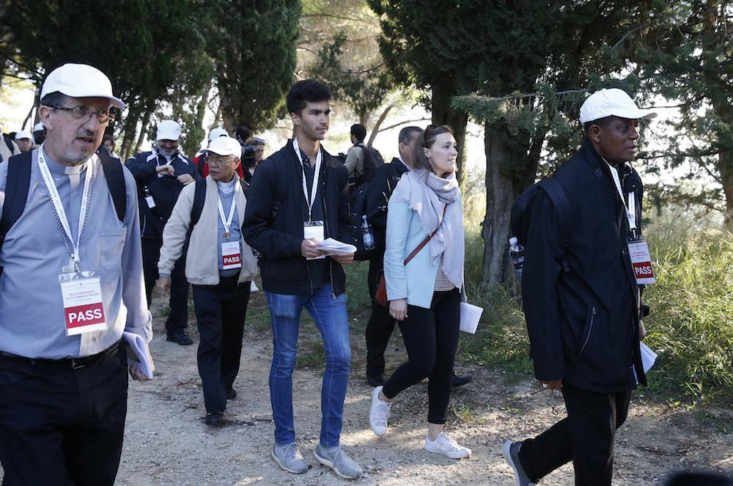
What is Synodality?
“Synodality is the way of being the Church today according to the will of God, in a dynamic of discerning and listening together to the voice of the Holy Spirit.”
Pope Francis
“Journey together”
Notes:
Synodality enables the entire People of God to “journey together” in authentic listening and discernment on the path of becoming the Church that God calls us to be.

Slide 9
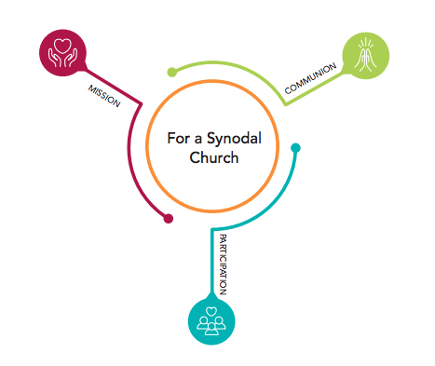
Communion, Participation
and Mission
–
3 indispensable keys
at the heart
of a Synodal Church
Notes:
The practice of living as a synodal Church means :
The conversations lead to conversion to Christ and commitment to active participation in the mission given by Christ – Communion.
The people of God talk with one another and listen to one another about questions that matter – participation
The communion exists for a common purpose; mission flows naturally from the experience of communion – Mission.
Three keys are at the heart of this process…
A synodal church fosters communion – so we are working together, fostering participation – so we can each bring our gifts and voices to the church family, which fosters mission – to focus our energies where they are most needed.
Remember to define terms for your audience:
When you connect in a meaningful way with something, or intimately share your feelings with someone, you experience a communion. The word implies a deep connection, particularly a spiritual one. ... The Latin root of communion is communionem, meaning "fellowship, mutual participation, or sharing."

Slide 10
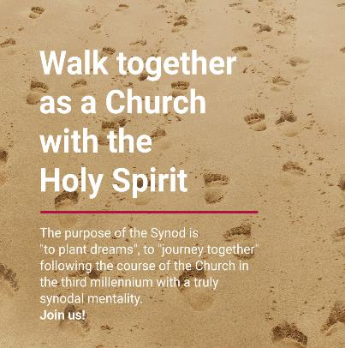
Objectives of the Synod (PD, 2)
Witness God’s love in history and today
Opportunity for everyone express themselves & be heard
Gifts and charisms from Spirit to benefit all
Proclaim the Gospel to make a better world
Notes:
Objectives of the process, slide 1/2
recalling how the Spirit has guided the Church’s journey through history and, today, calls us to be, together, witnesses of God’s love;
living a participative and inclusive ecclesial process that offers everyone—especially those who for various reasons find themselves on the margins—the opportunity to express themselves and to be heard in order to contribute to the edification and growth of the People of God;
recognizing and appreciating the wealth and the variety of the gifts and charisms that the Spirit liberally bestows for the good of the community and the benefit of the entire human family;
exploring participatory ways of exercising responsibility in the proclamation of the Gospel and in the effort to build a more beautiful and habitable world – our relationship with Christ should lead us to conversion, and that conversion should be life giving to the whole community
** the goal is not the papers written, but SPEAKING with one another, getting to know each other
Remember to define terms for your audience:
Charisms, spiritual gifts, are special abilities, a special empowerment, given to a Christian by the Holy Spirit to enable them to be powerful channels of God’s love and redeeming presence in the World. Whether extraordinary or ordinary, charisms are to be used in charity or service to build up the Church (CCC, 2003)
A charism is always deeply connected with our faith and is an expression of our relationship with God. In this way it differs from a natural or learned ability. A charism, exercised correctly, draws other people to God. For instance, we can take art courses and learn to paint a picture. The ceiling of the Sistine Chapel, however, draws people to God. Stained glass windows in a church do the same.

Slide 11

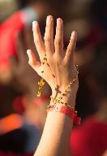
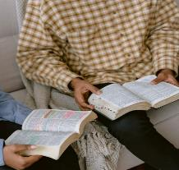
Emphasis on Prayer
and Discernment
Grounded in Word of God, Liturgy
Discernment = using prayer to make a decision in line with the Holy Spirit
Listen to others, listen to Holy Spirit for the good of all
Shared experience
Not one-time event: a process
Notes:
This Synod is not an opportunity to air grievances or promote agendas. It is an opportunity to listen to the Holy Spirit together.
We begin in a spirit of prayer, grounded in the liturgy and the Word of God
Listen to one another in order to listen to the Holy Spirit
An experience shared with one another, not just filling out a questionnaire
A process, not a one-time event
Discerning together so that the decisions made are for the good of all
Remember to define terms for your audience:
The fundamental definition for Christian discernment is a decision making process in which an individual makes a discovery that can lead to future action. In the process of Christian spiritual discernment God guides the individual to help them arrive at the best decision. When we are discerning we are sifting through or sorting things out. As Catholics we can do this sorting through with the assistance of the Holy Spirit in prayer.

Slide 12

Establishing Ground Rules
Stay on topic.
Listen respectfully, without interrupting and with the aim of understanding each others’ views.
Commit to learning, not debating.
Avoid blame, speculation, and inflammatory language.
Allow everyone the chance to speak.
Notes:
Ground rules create an atmosphere of mutual respect and collaborative inquiry … because difficult topics may arise, it is important that everyone is on the same page before the discussion begins. These rules can be referred back to if conversations become tense or difficult. A facilitator may need to stop the discussion and remind participants of the reason they are gathered and of the ground rules. Facilitators may also feel the need to pause to pull a combative individual aside and speak to them privately before continuing.
Source: https://crlt.umich.edu/publinks/generalguidelines

Slide 13

Discussion Questions
Who has Christ sent to encourage and support you in your life, in your faith, in your parish and in Church?
Notes:
Your parish listening sessions will be rooted in the following 10 questions written by our Archbishop after a period of prayer, reflection and discernment. It is important to note that these questions were not spontaneous, but the result of how our Archbishop sees the spirit moving through our local Church at this time. Your group may not be able to answer all 10 questions. Pastors may elect to pick and choose the questions he would like his parish to address or adapt the language to better suit the local context.

Slide 14

Discussion Questions
How do we hear the voice of Christ in the Church? How do we hear Him on the edges of our communities?
Notes:
Your parish listening sessions will be rooted in the following 10 questions written by our Archbishop after a period of prayer, reflection and discernment. It is important to note that these questions were not spontaneous, but the result of how our Archbishop sees the spirit moving through our local Church at this time. Your group may not be able to answer all 10 questions. Pastors may elect to pick and choose the questions he would like his parish to address or adapt the language to better suit the local context.

Slide 15

Discussion Questions
What enables or hinders us in hearing the voices of others in our parish communities and in our Church?
Notes:
Your parish listening sessions will be rooted in the following 10 questions written by our Archbishop after a period of prayer, reflection and discernment. It is important to note that these questions were not spontaneous, but the result of how our Archbishop sees the spirit moving through our local Church at this time. Your group may not be able to answer all 10 questions. Pastors may elect to pick and choose the questions he would like his parish to address or adapt the language to better suit the local context.

Slide 16

Discussion Questions
How do Mass and communal prayer inspire and strengthen you? For your decisions? Prepare us for our mission in the world?

Slide 17

Discussion Questions
What is the mission of the Church? How is this realised in your parish and in the archdiocese? How do you fit into this mission?

Slide 18

Discussion Questions
What particular issues in the Church and society need conversion in the light of the Gospel?

Slide 19

Discussion Questions
What might build up a closer communion with our brothers and sisters of other Christian traditions?

Slide 20

Discussion Questions ​
How does the Church support, encourage and serve our participation in its life and mission?

Slide 21

Discussion Questions ​
How do we, as individuals, as parishes and as an archdiocese, discern and make decisions in the light of the Gospel?

Slide 22

Discussion Questions
How does listening to Christ prompt us to hear one another, encourage us to participate in mission and help us to reflect Him to those we encounter?

Slide 23
Time to Summarize!
Note taker or scribe, in consultation with participations, summarize the major themes of the listening sessions

