Slide 1
Liturgy of the Word on Sunday
in Exceptional Circumstances

Slide 2
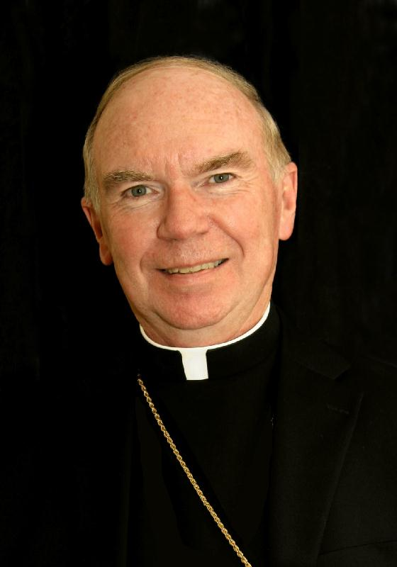
Decree of the Archbishop
I authorize this Ritual to be used in emergency situations when the celebration of the Eucharist is impossible.
+ Brendan M, O’Brien
Archbishop of Kingston December 8, 2016
The celebration of the Sunday Eucharist is the source and summit of the Christian and Parish life and should not be replaced by any other celebration except in the most serious and urgent circumstances. Therefore, this Ritual is not to be used to replace the Sunday Eucharist in ordinary circumstances.

Slide 3
Part One
Liturgy of the Word

Slide 4
Parts of the liturgy – Roman Missal
Ordinary of the Mass
  The unchanging prayers and parts
  Found in the centre of the Missal
  Examples: Sign of the Cross, Glory to God, Creed, Lord’s Prayer, etc.
Proper of the Mass (Proper to the Sunday or Solemnity)
  The changing prayers and parts
  Found in the front (Sundays and Solemnities of the Lord) and rear (Feasts and Saints)
  Examples: Collect

Slide 5
Parts of the Liturgy – local choices
Entrance Hymn
Homily / Reflection
Prayer of the Faithful
Announcements
Closing Hymn

Slide 6
Three parts to order of Service
Introductory Rites
Liturgy of the Word
Concluding Rite

Slide 7
1) Introductory Rites
Entrance Hymn and Procession
Explanatory Rite (Insert)
Sign of the Cross and Greeting (Ordinary and Insert)
Penitential Act (Form 3) (Ordinary)
Glory to God (except in Advent and Lent) (Ordinary)
Collect Prayer (Proper to the Sunday)

Slide 8
2) Liturgy of the Word
First Reading (Lectionary)
Responsorial Psalm (Lectionary)
Second Reading (Lectionary)
Gospel Acclamation (Lectionary)
Gospel (Lectionary)
Reflection / Homily
Silence
Profession of Faith – Creed (Missal - Ordinary)
Prayer of the Faithful (Local)
Collection
Lord’s Prayer and “Deliver Us” (Missal - Ordinary)
Prayer for Spiritual Communion (Insert)

Slide 9
3) Concluding Rite
Announcements (Local)
Blessing (Ordinary - Insert)
Dismissal (Ordinary - Insert)
Closing Hymn and Recessional

Slide 10
Part two
liturgical books

Slide 11
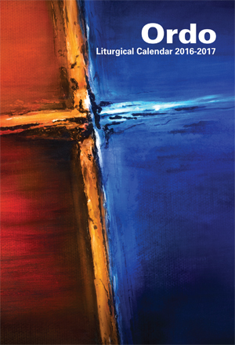
What you will need: Liturgical Books
ORDO (Liturgical Calendar)

Slide 12
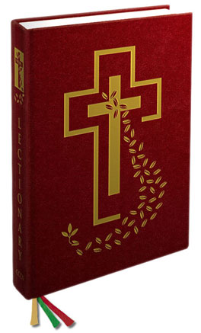
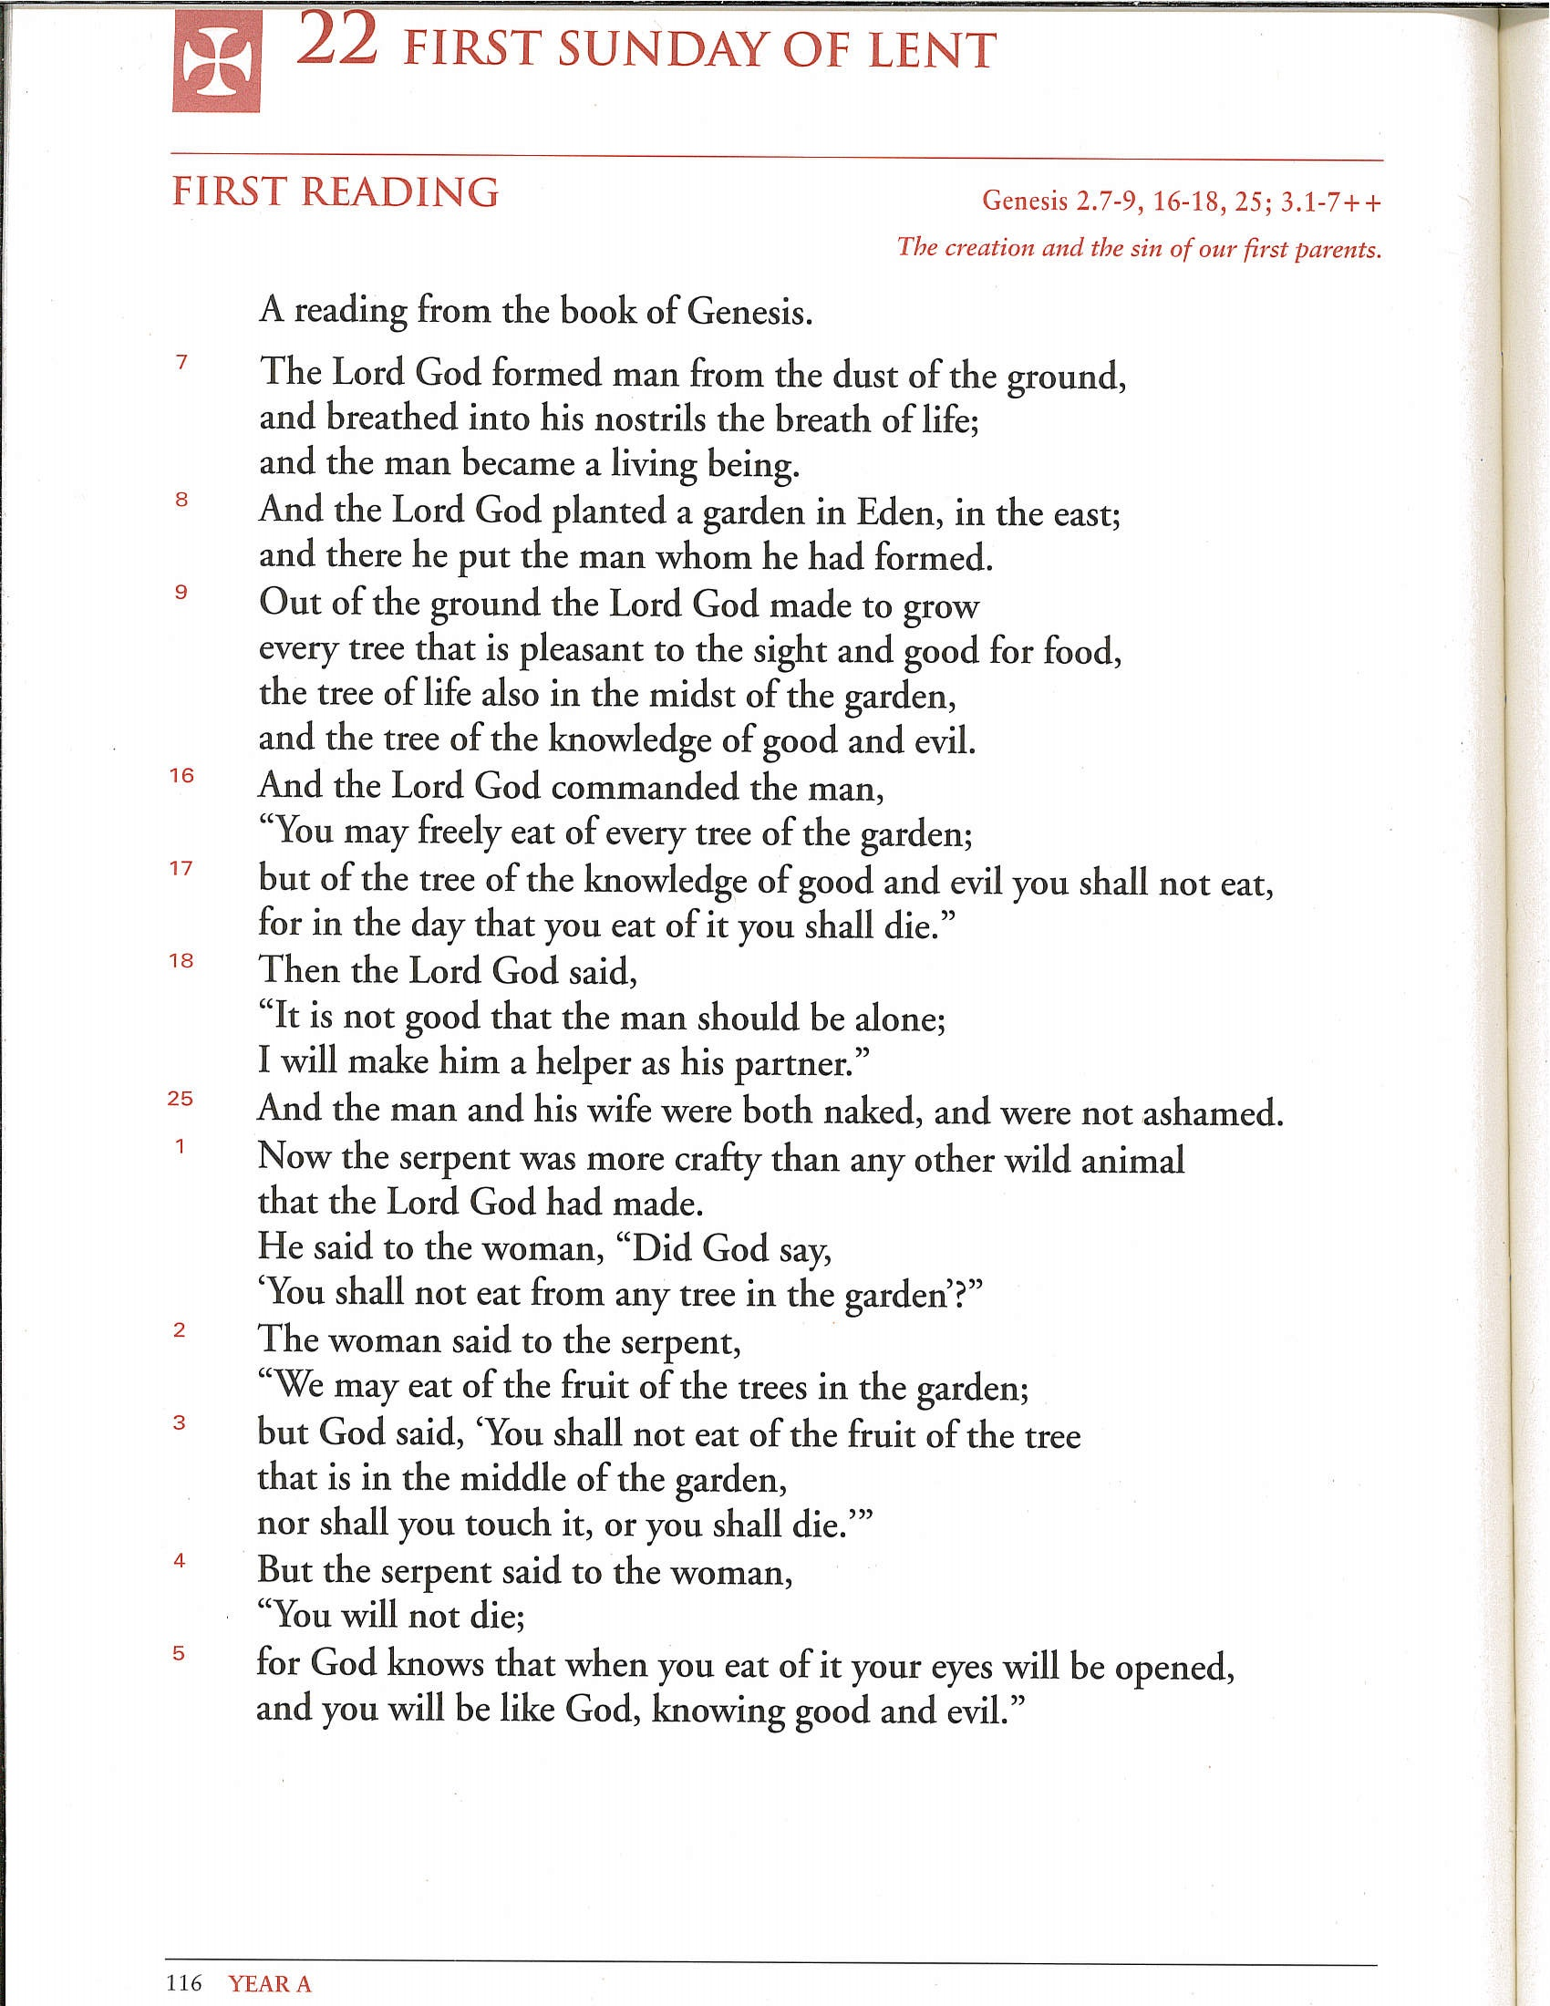
What you will need: Liturgical Books
Lectionary For Sundays and Solemnities

Slide 13
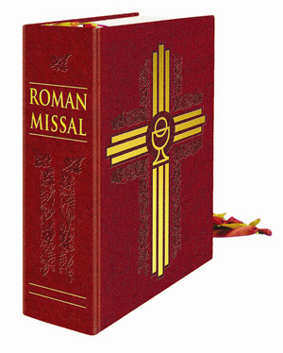
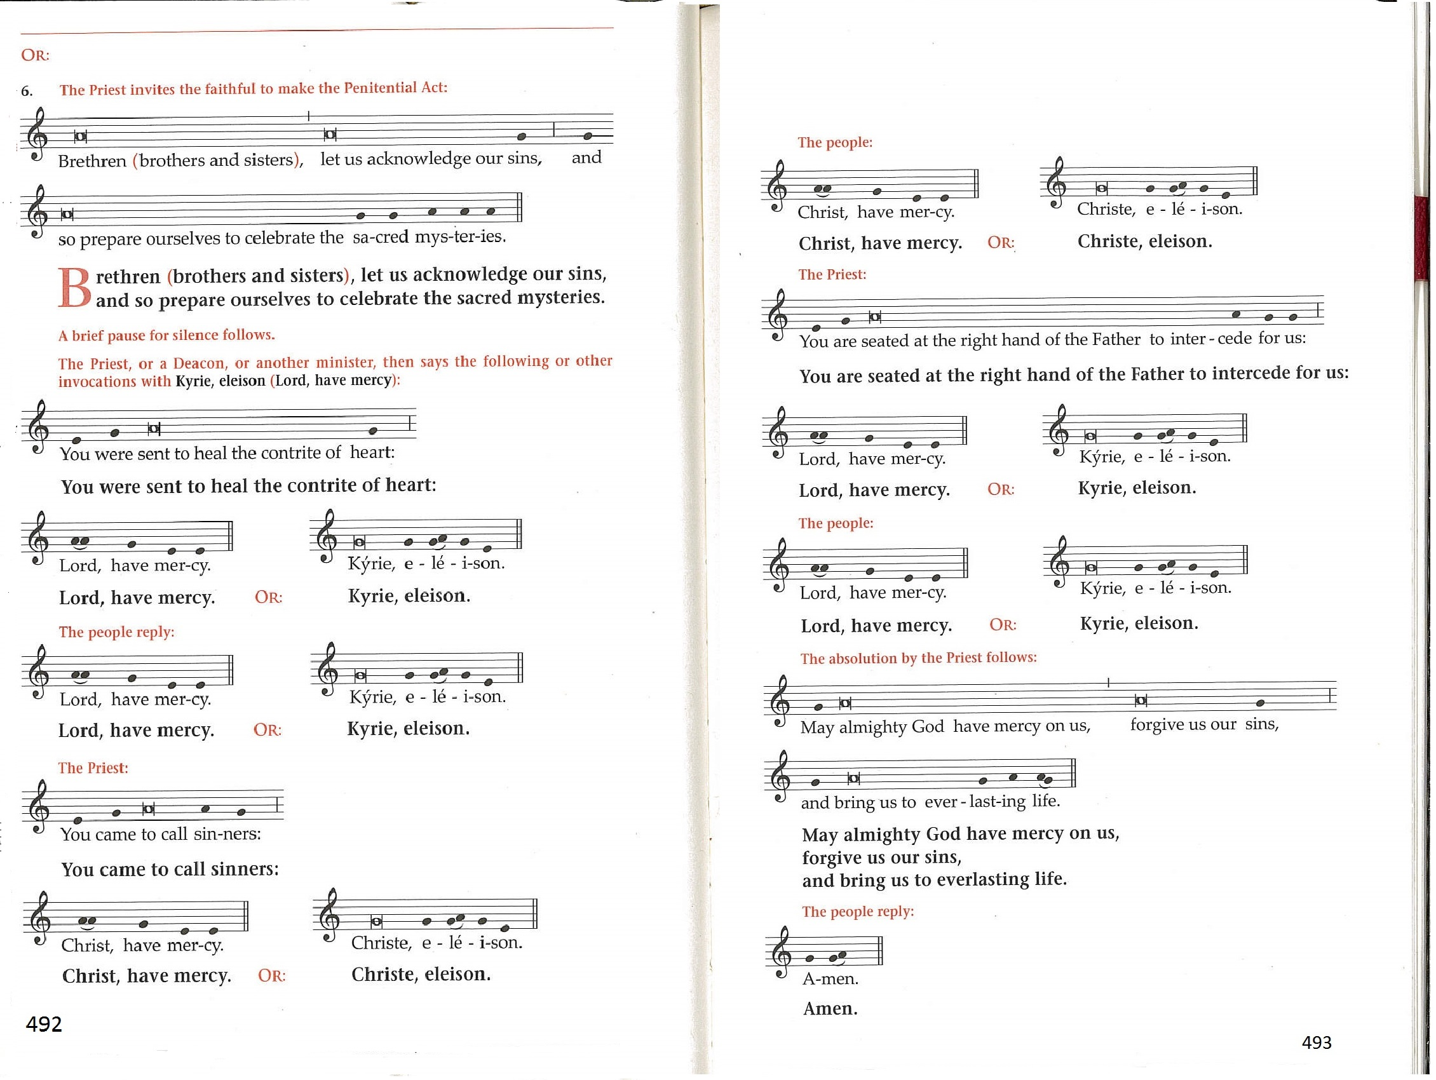
What you will need: Liturgical Books
Roman Missal (Canadian Edition)

Slide 14
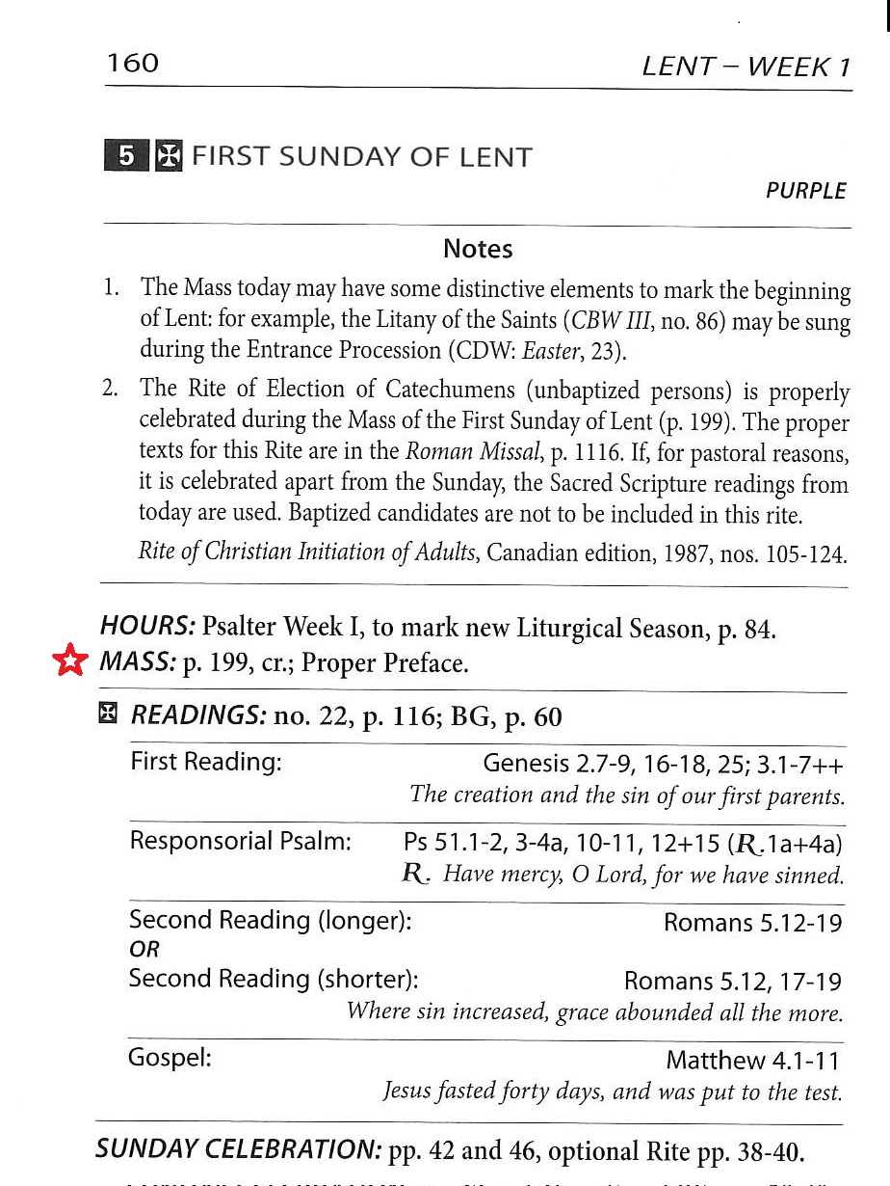
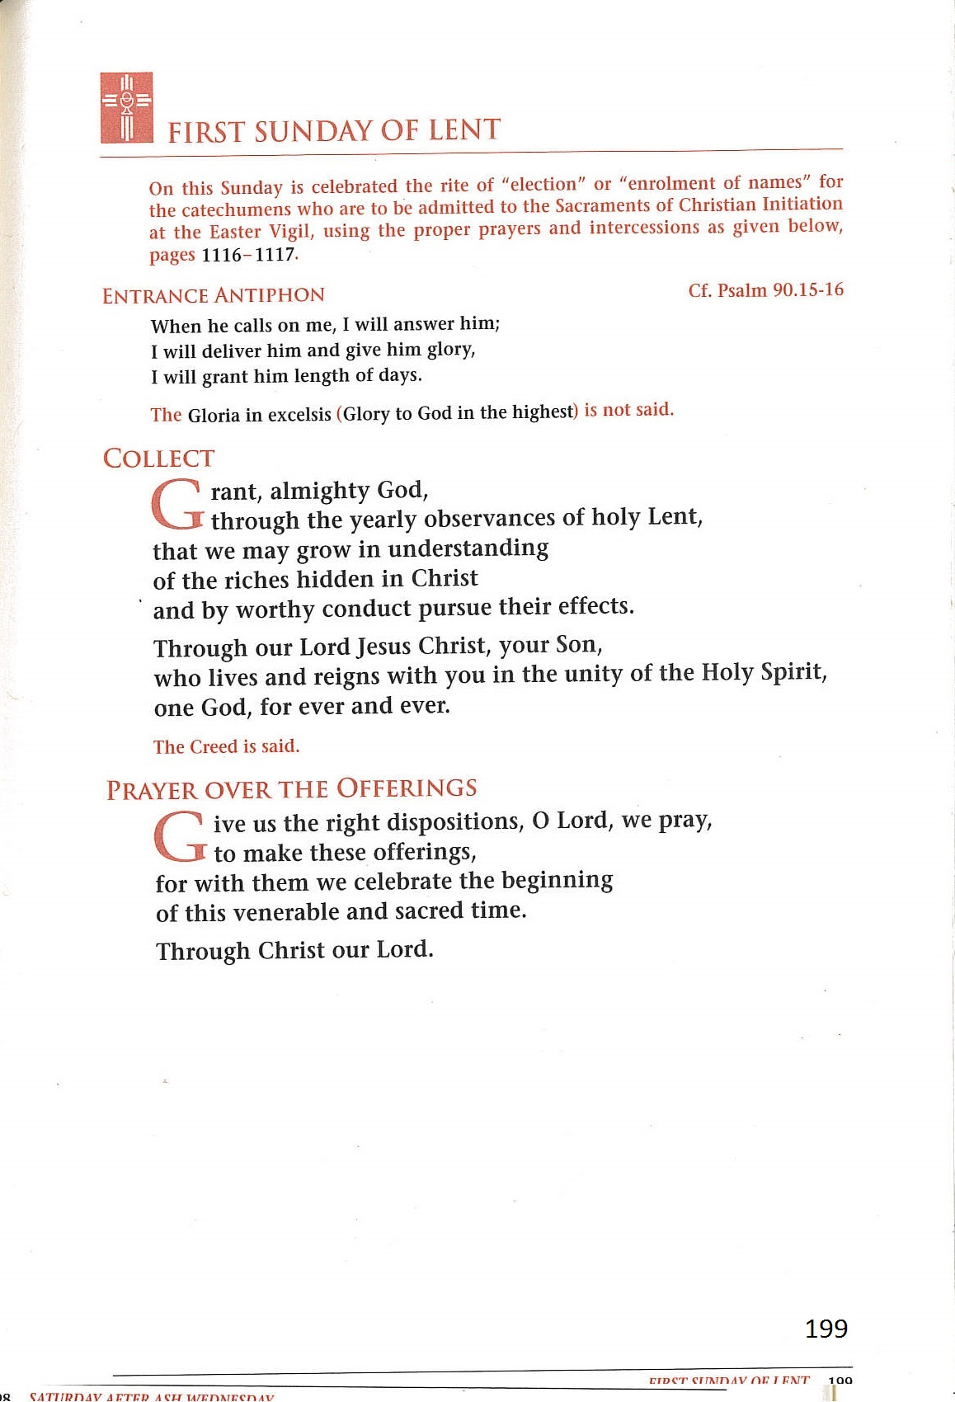
Using the
Ordo
Finding the Collect
of the
Mass
cr = Creed
No Gloria

Slide 15

Using the
Ordo
Finding the Readings
BG = Book of Gospels

Slide 16
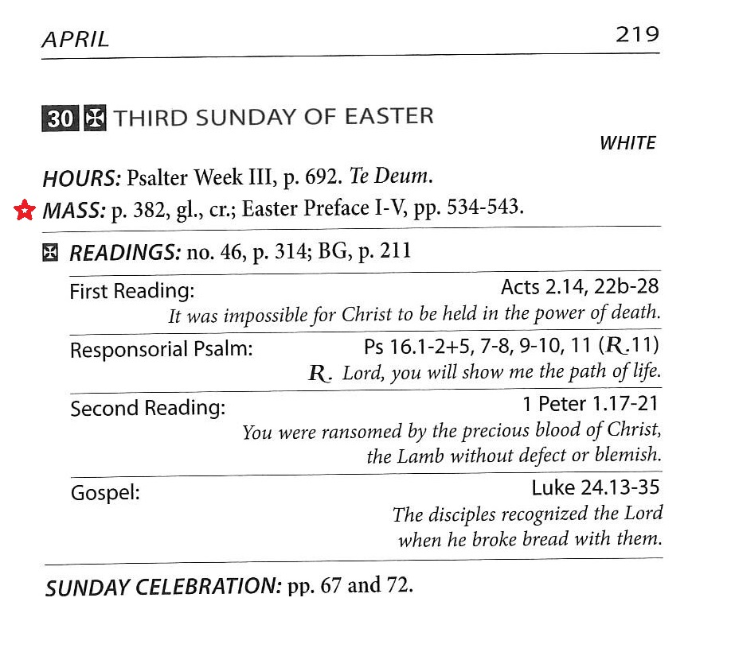
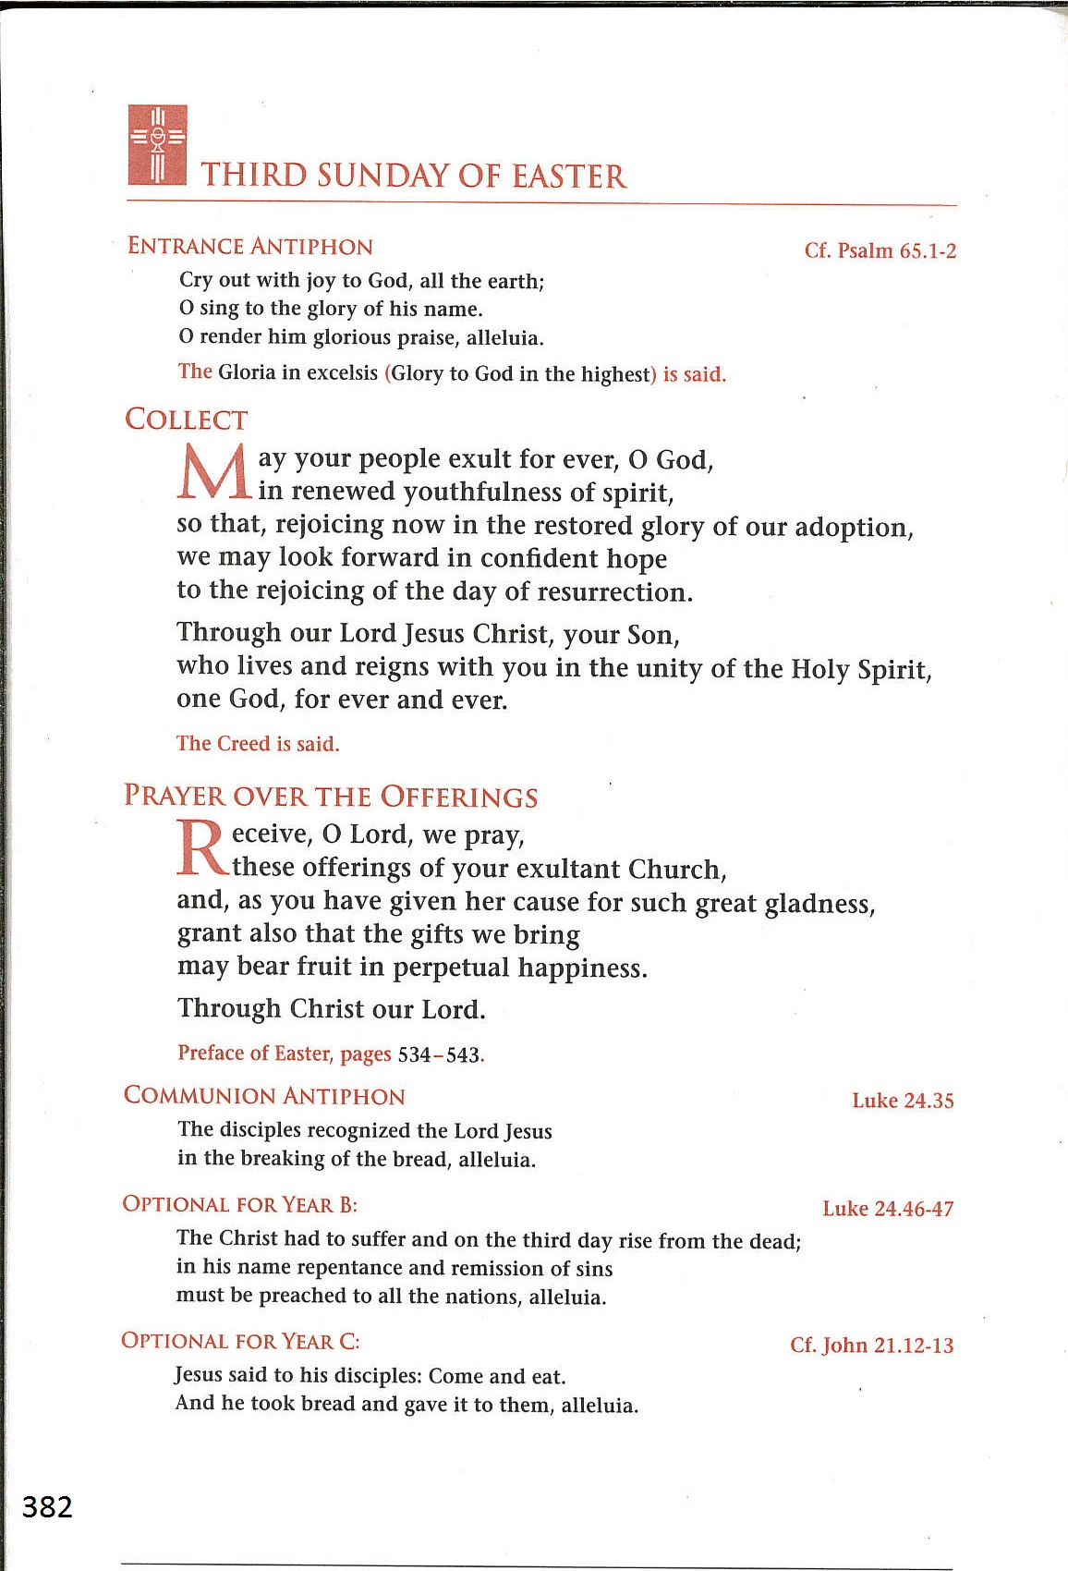
Ordo
Gl = Gloria
Cr = Creed
Both Gloria and Creed are used this Sunday

Slide 17
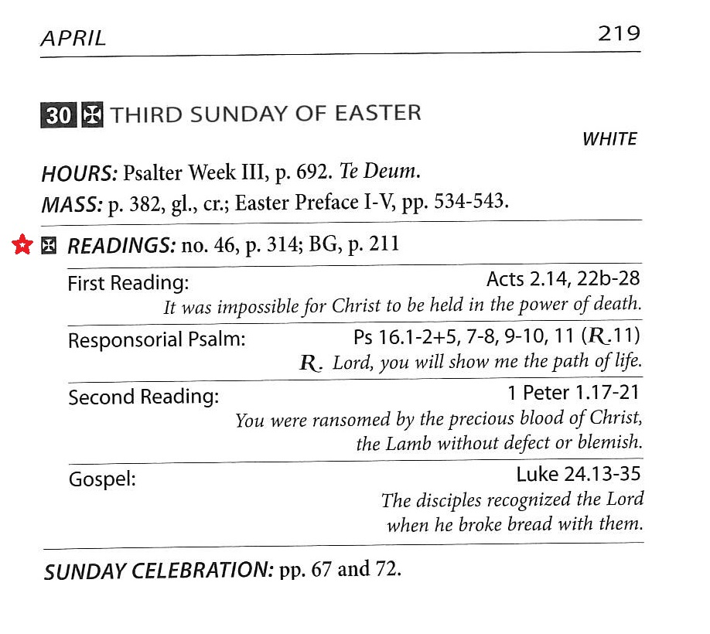
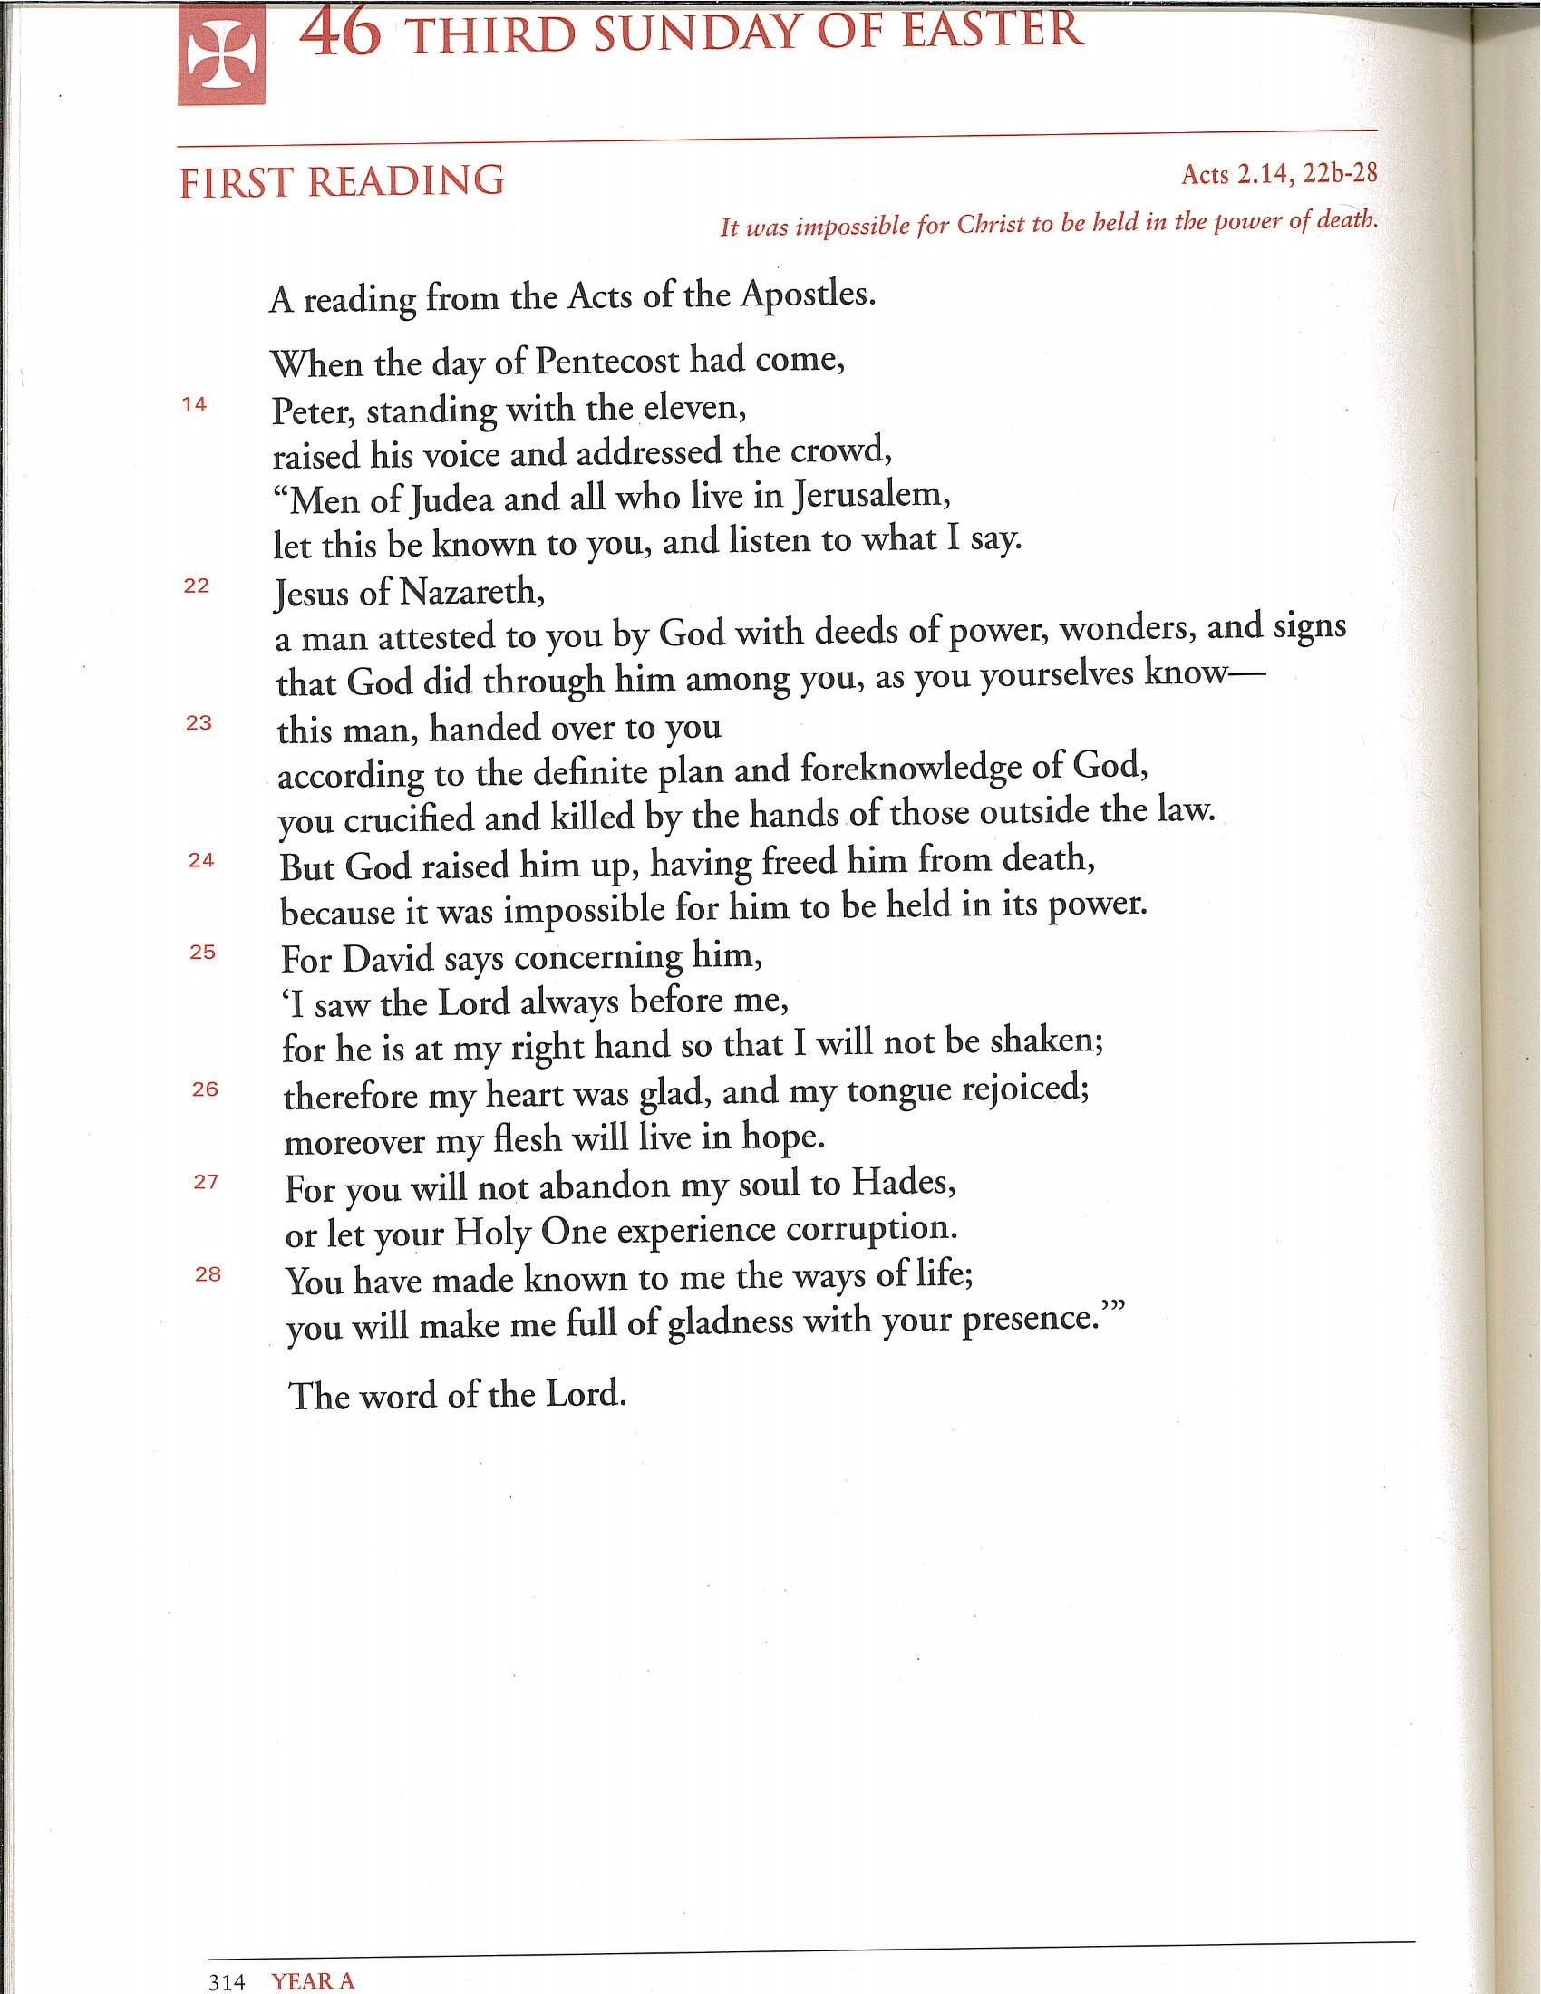
Ordo

Slide 18
Preparations
Place inserts 1 and 2 in Roman Missal
Give Insert 3 to the Musicians (Find out what is being sung)
The “Lord, have mercy” is not sung, but the “Glory to God” is (expect Advent or Lent)
Place a chair (and small lectern, if no server) next to or near the Priest’s chair
Find the Prayer of the Faithful
Is there a Homily or Reflection available?
Will the Book of Gospels be used?
Altar candles are lighted as usual
Turn on the P.A. System and prepare microphone(s)

Slide 19
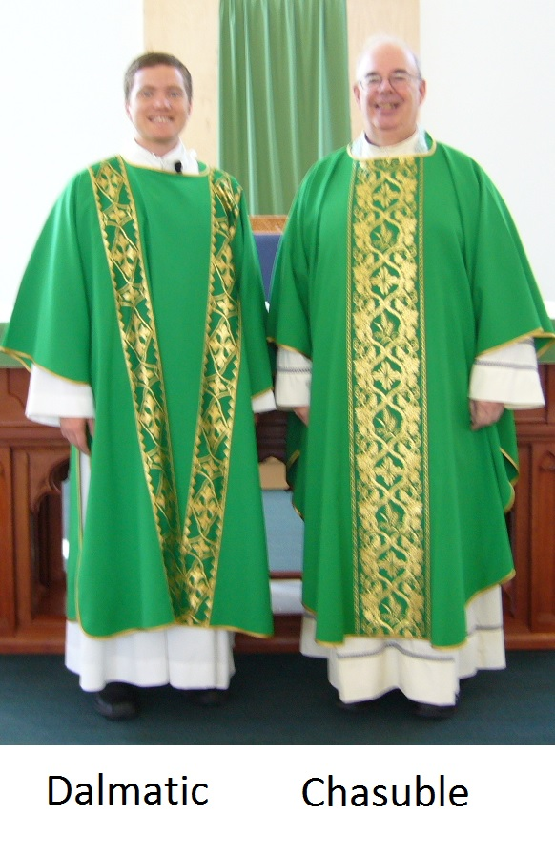
Preparations
Find an alb or gown (white) to wear, if possible
  A white alb is a sign of Baptism not Ordination
  A sign of Ordination is the stole and dalmatic for Deacons and stole and chasuble for Priests

Slide 20
Part three
using the missal / inserts and lectionary

Slide 21
understanding liturgical prayers
Penitential Act – collect – prayer of the faithful - lord’s prayer
Structure:
  Invitation to the people to pray (Let us pray / My brothers and sister…)
  Silence (or vocal prayer) for personal prayer
  Title and Address to God
  Remembrance (who …)
  Petition (grant, we pray…)
  Doxological Conclusion (Through Christ… / For the kingdom…)
  Assent of the people (“Amen”)

Slide 22
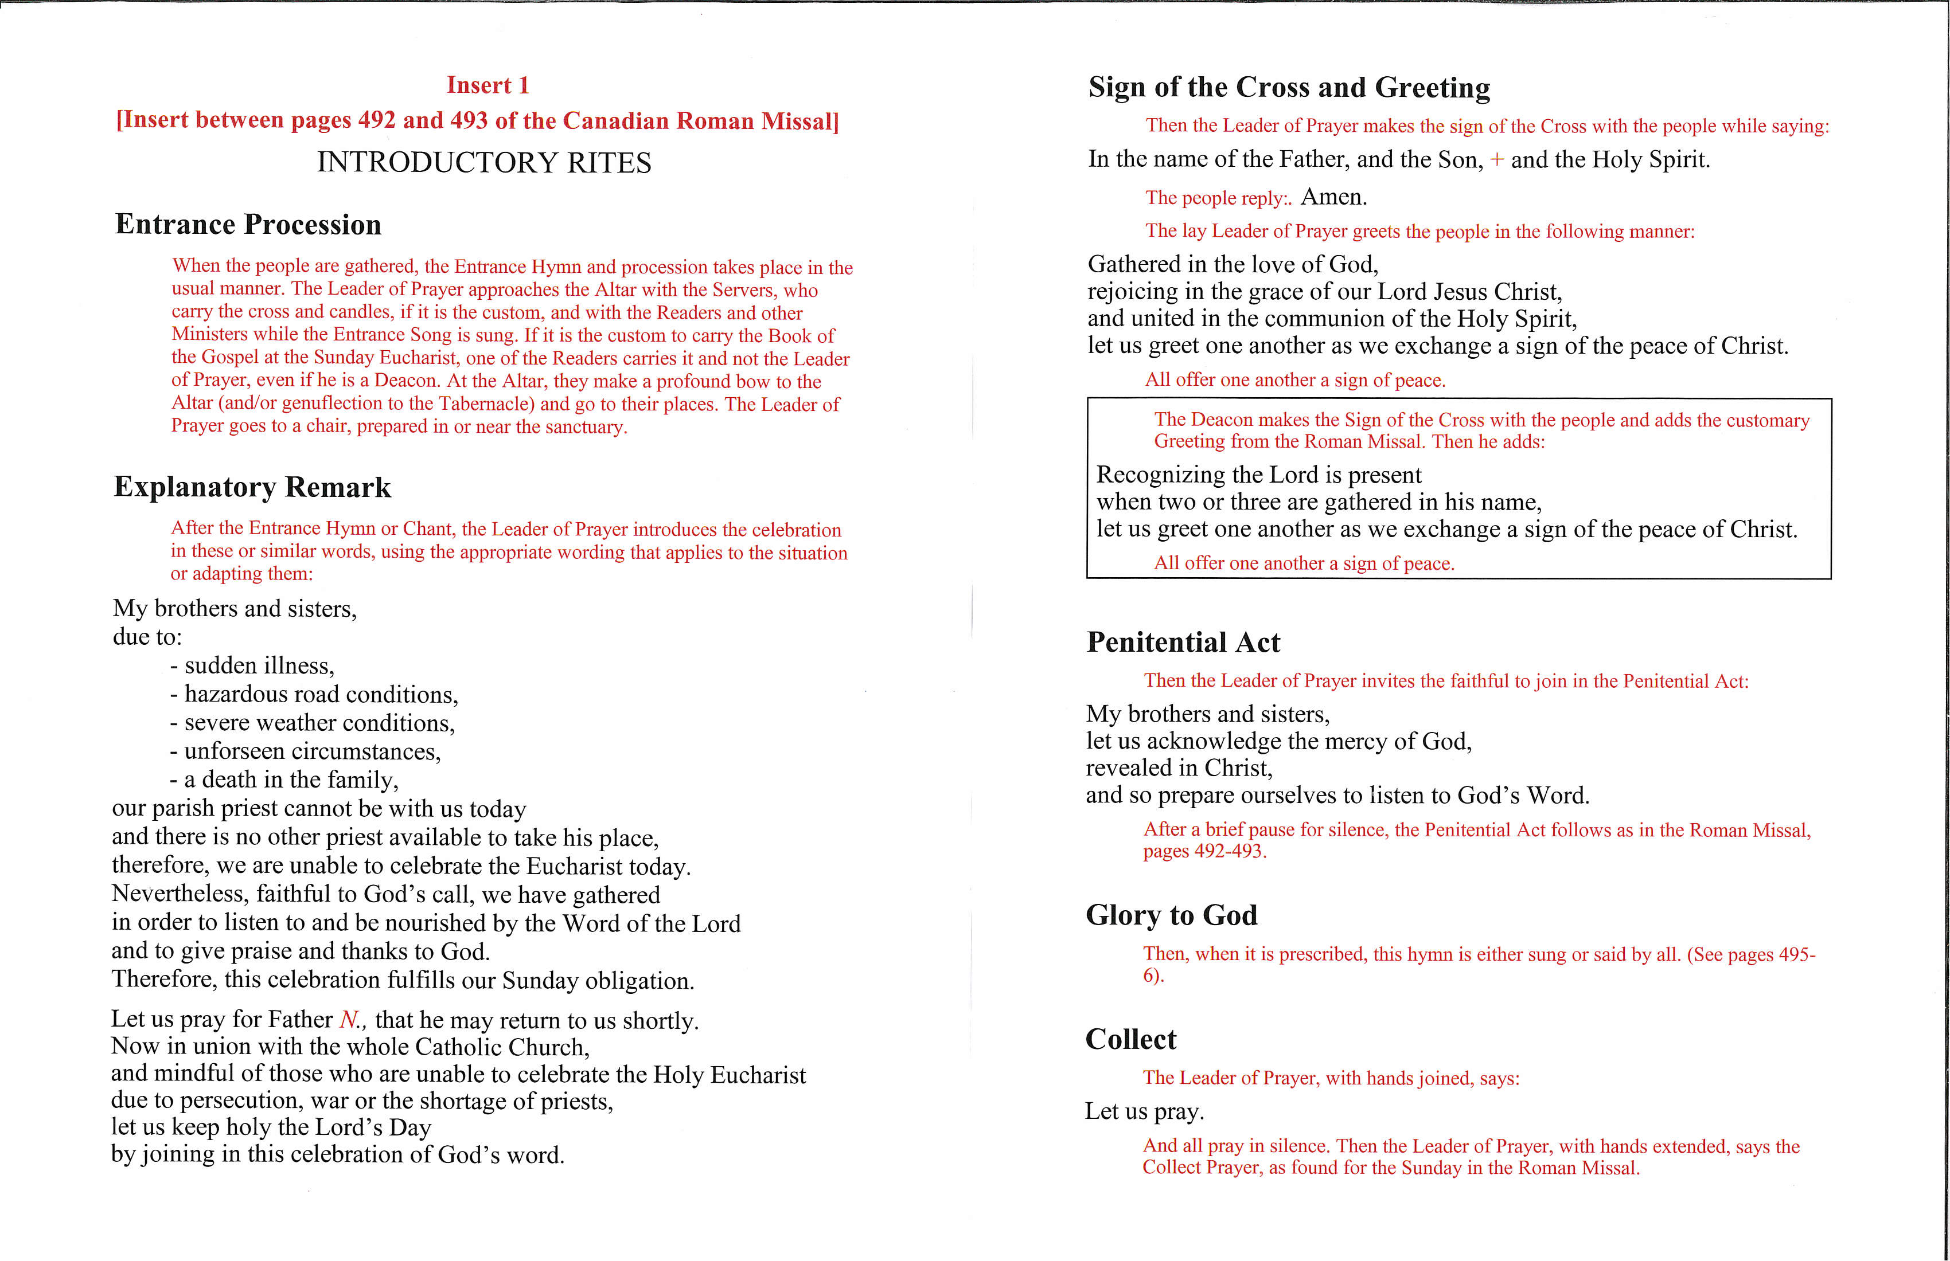
Roman missal - Beginning the Celebration

Slide 23
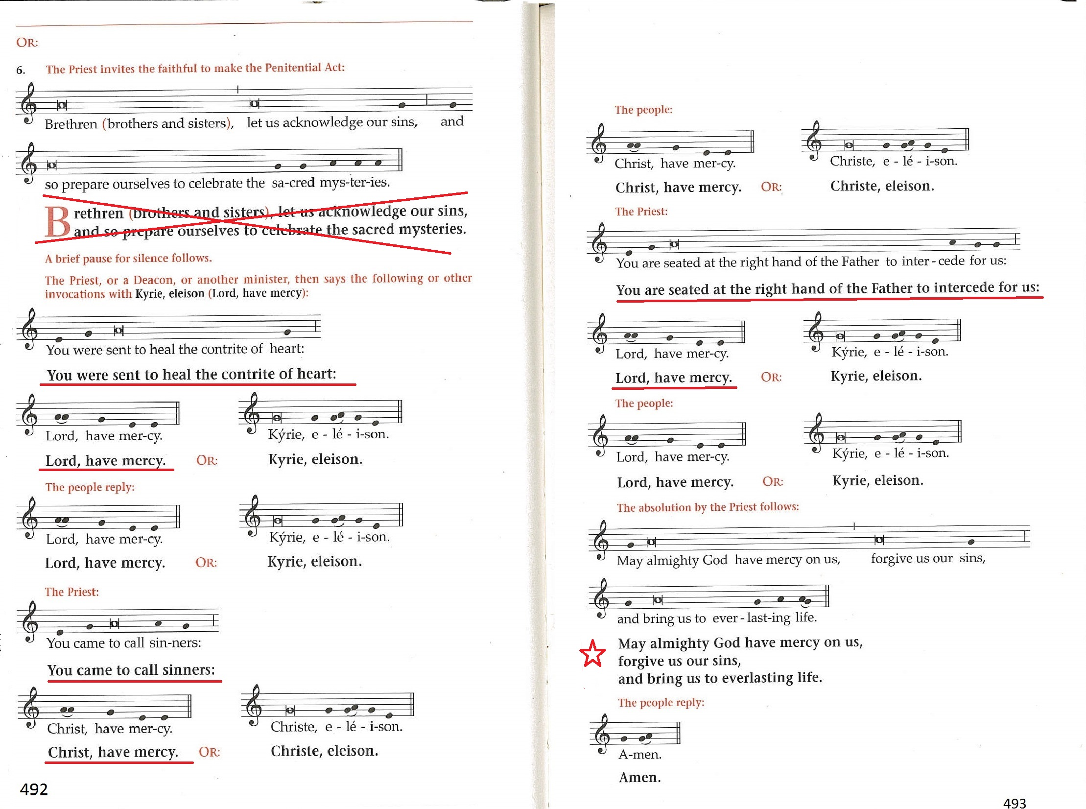
Roman Missal
Penitential act

Slide 24
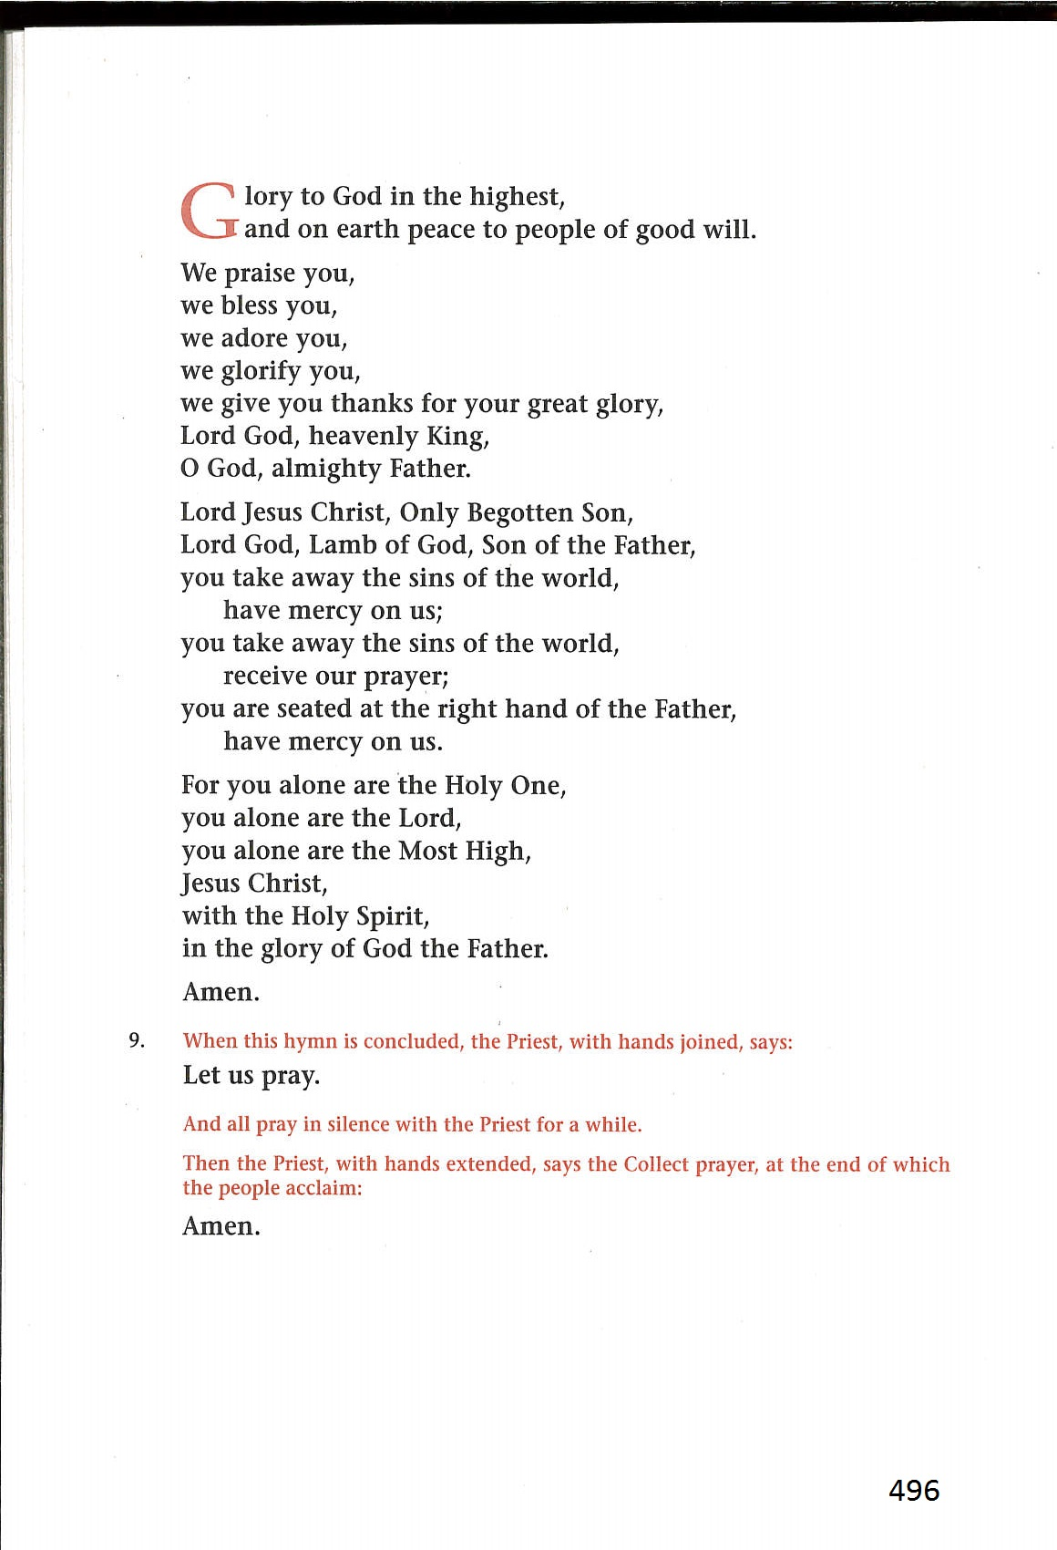
Roman Missal
Gloria
Not sung or recited
in Advent and Lent

Slide 25
Roman Missal
Collect
Practise the Collects:
They have a complex sentence
structure.

Slide 26
Roman Missal
Collect

Slide 27
Lectionary

Slide 28
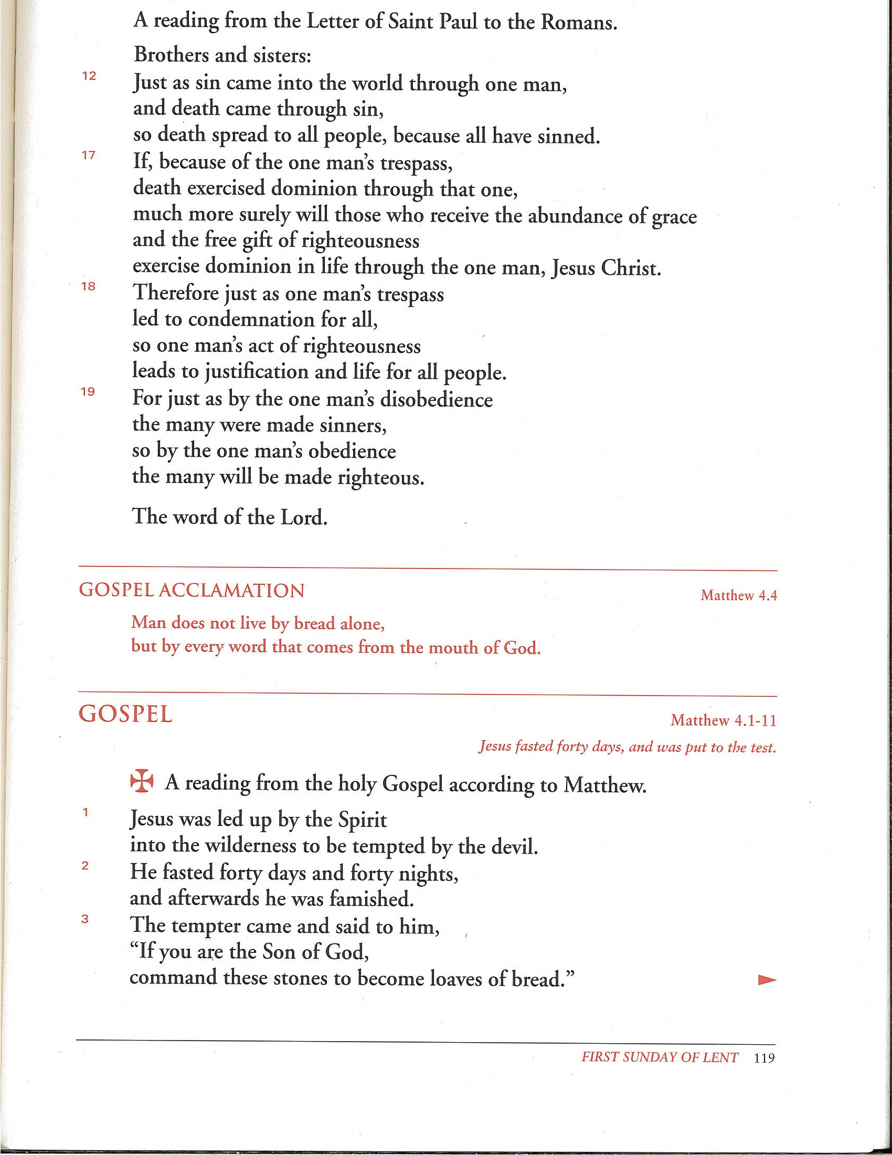
Lectionary
First Sunday of Lent
Year A - Gospel

Slide 29
Lectionary
Third Sunday of Easter
Year A

Slide 30
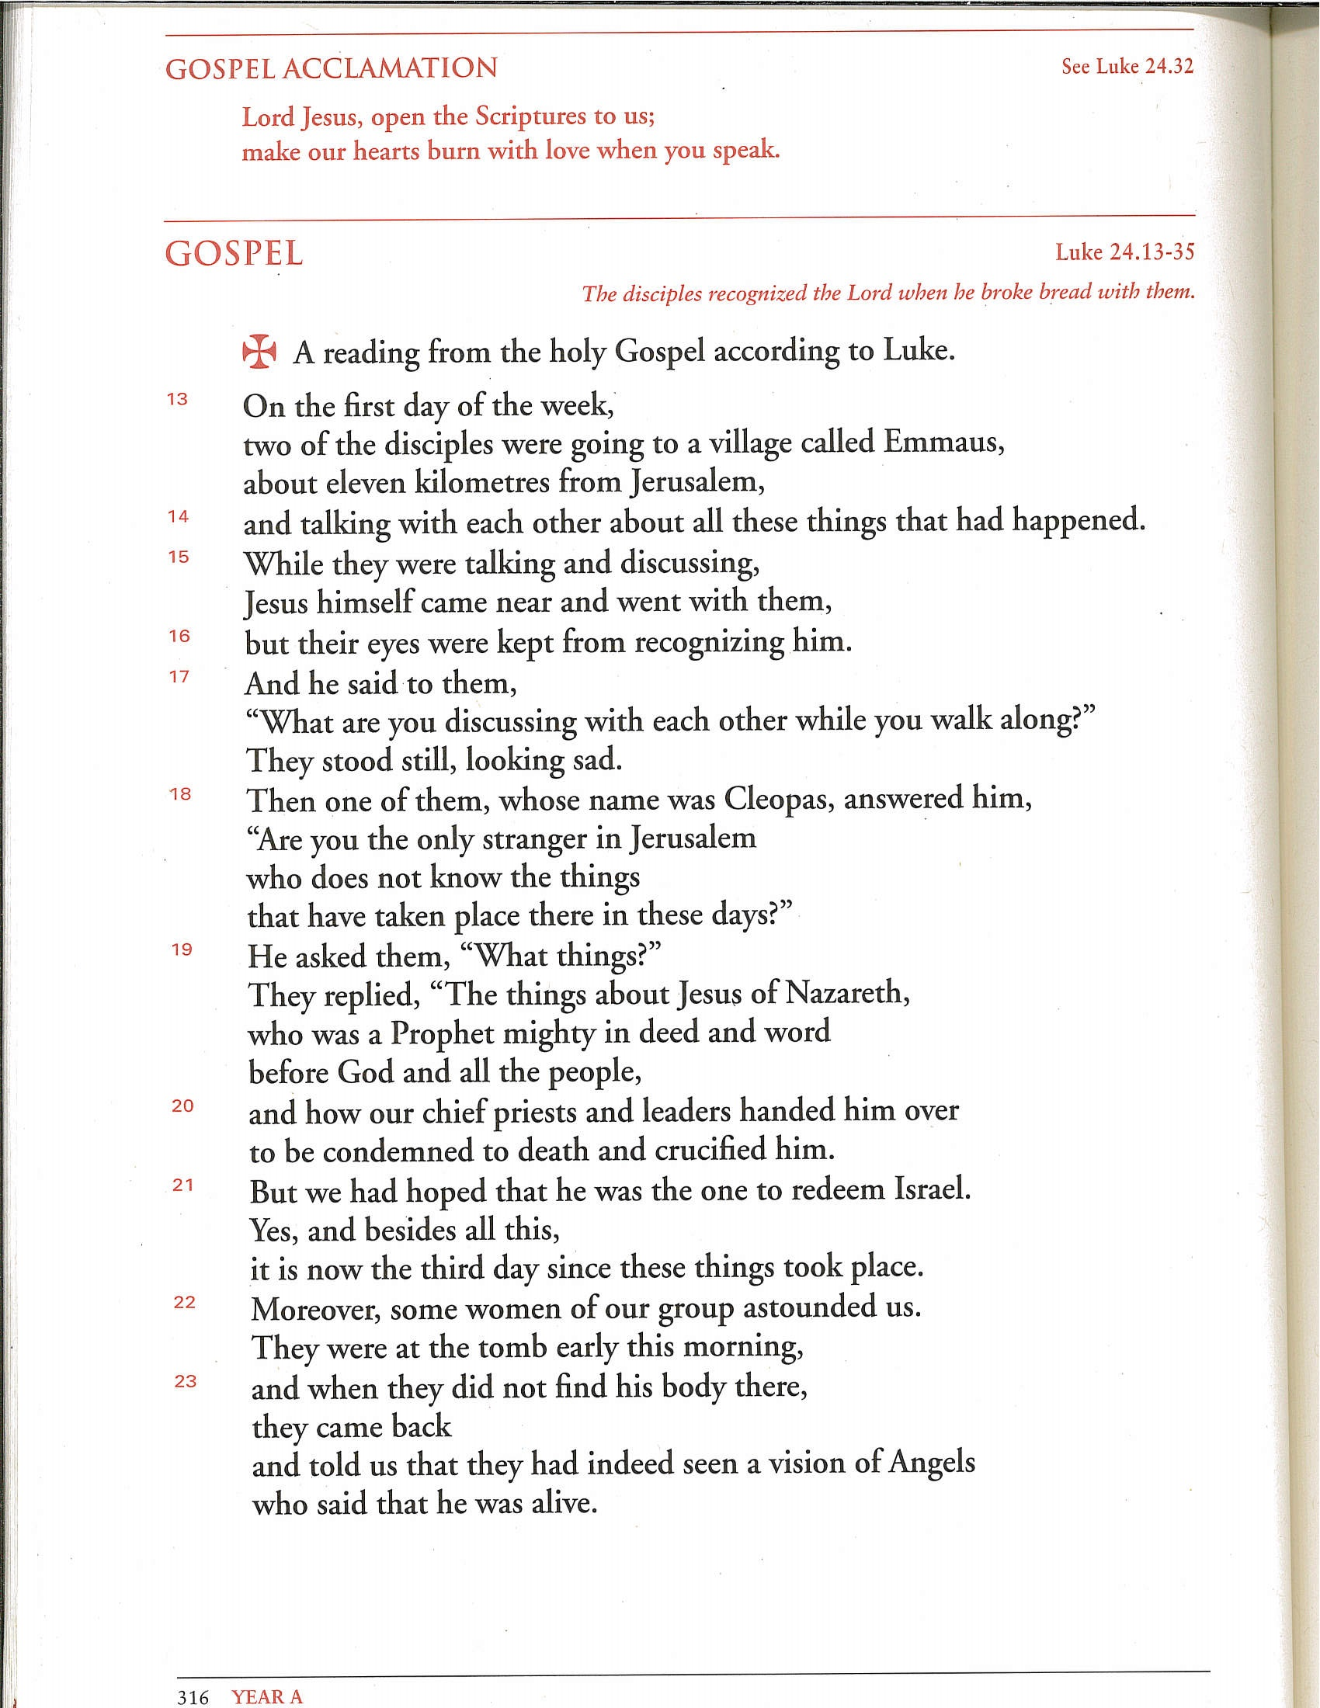
Lectionary
Third Sunday of Easter
Year A - Gospel

Slide 31
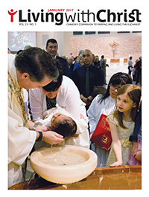
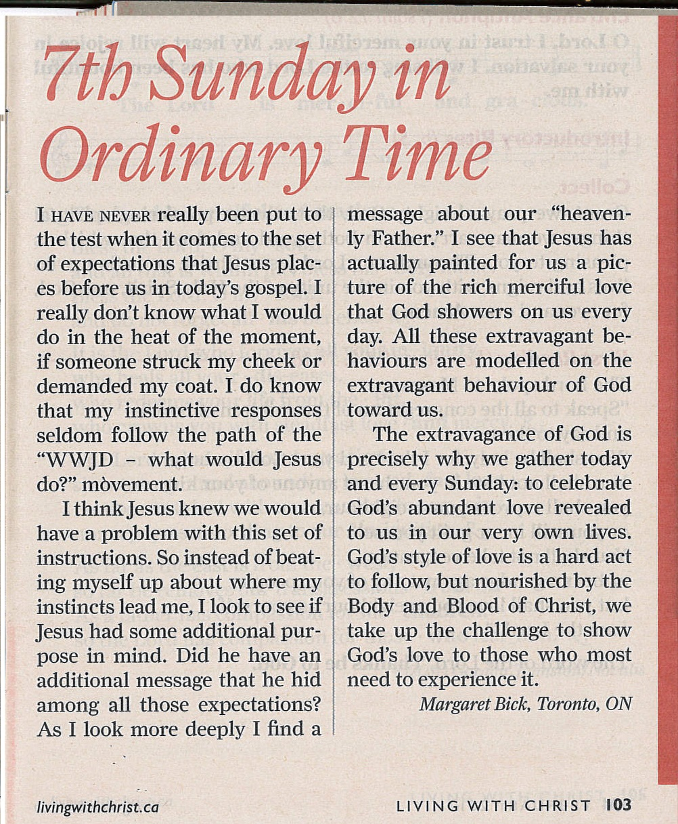
Reflection - Living with Christ (Monthly)

Slide 32

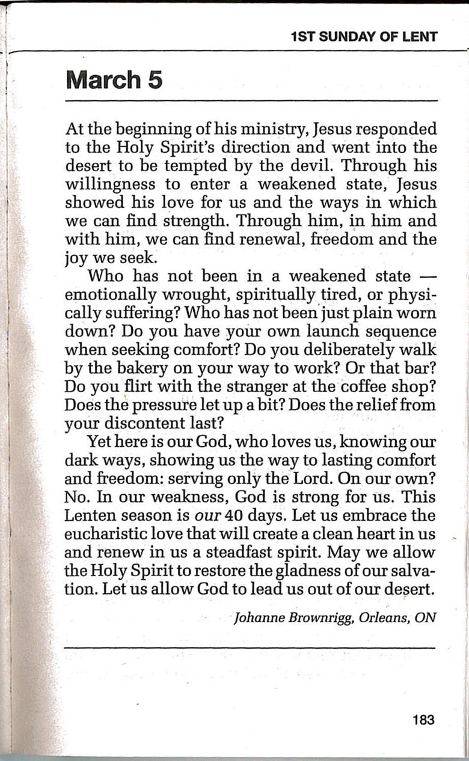
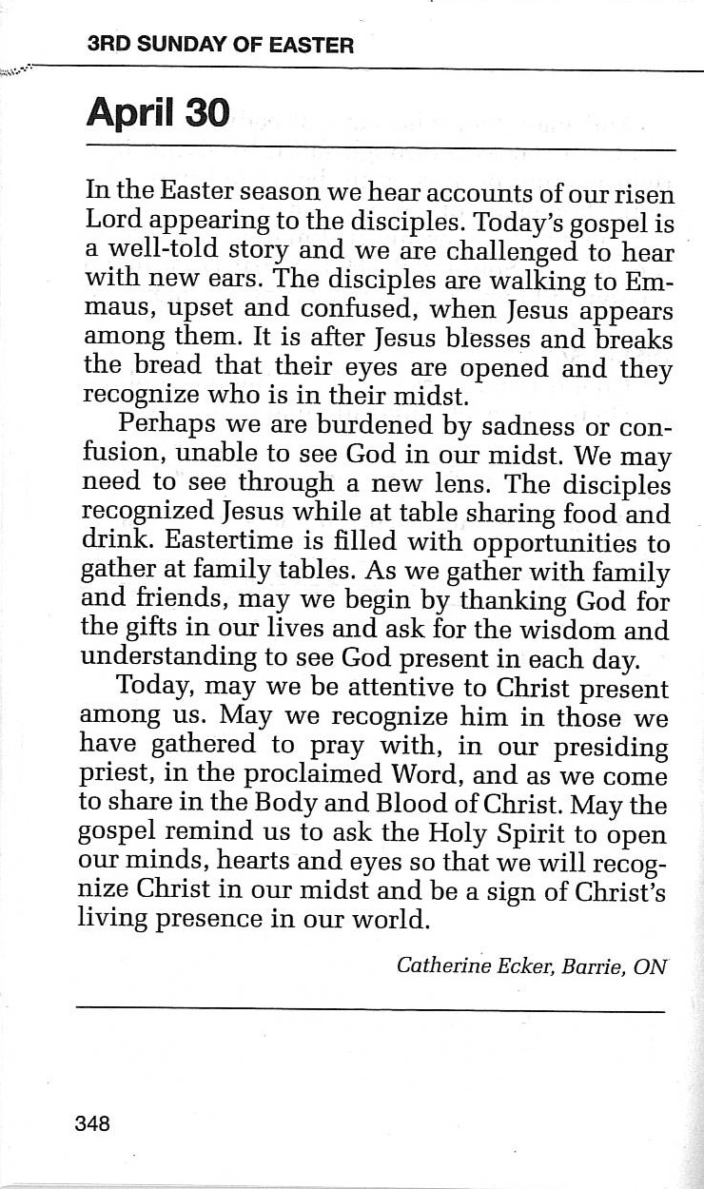
Reflection - Living with Christ (year)

Slide 33
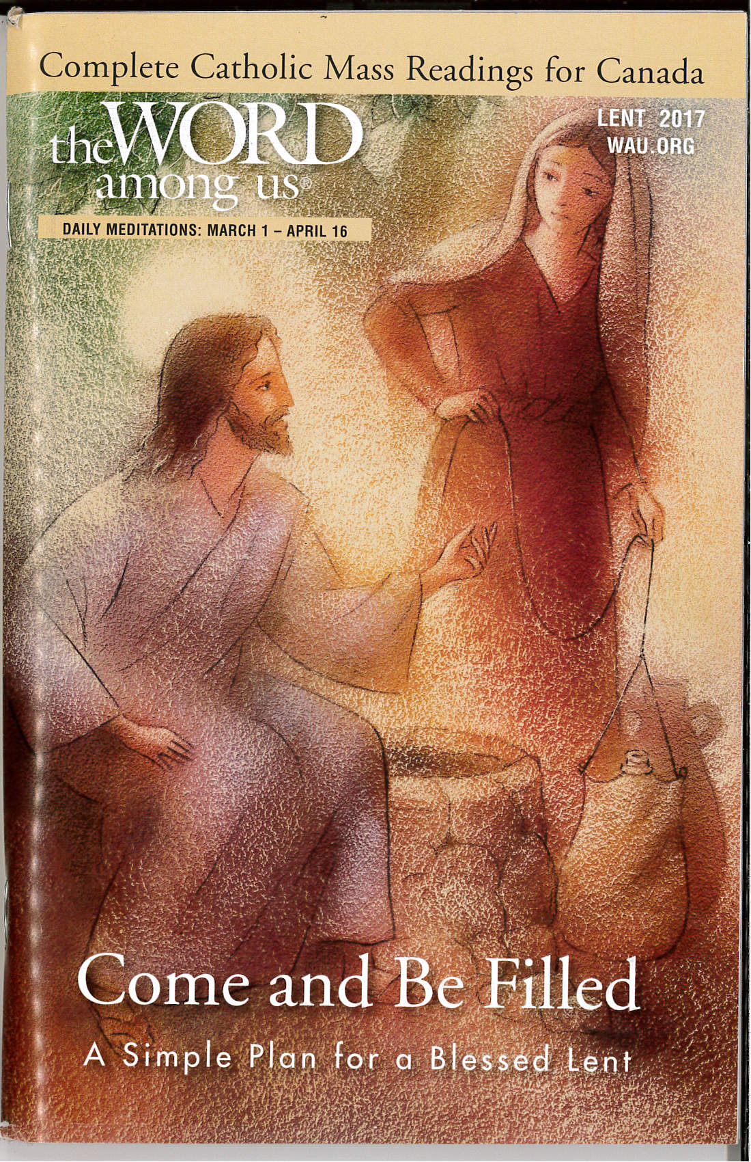
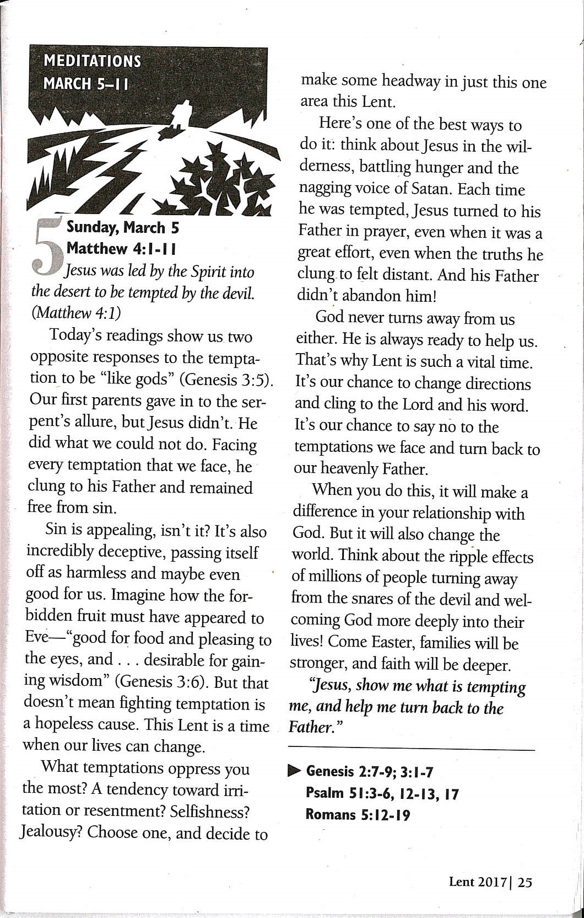
Reflection - The word among us

Slide 34
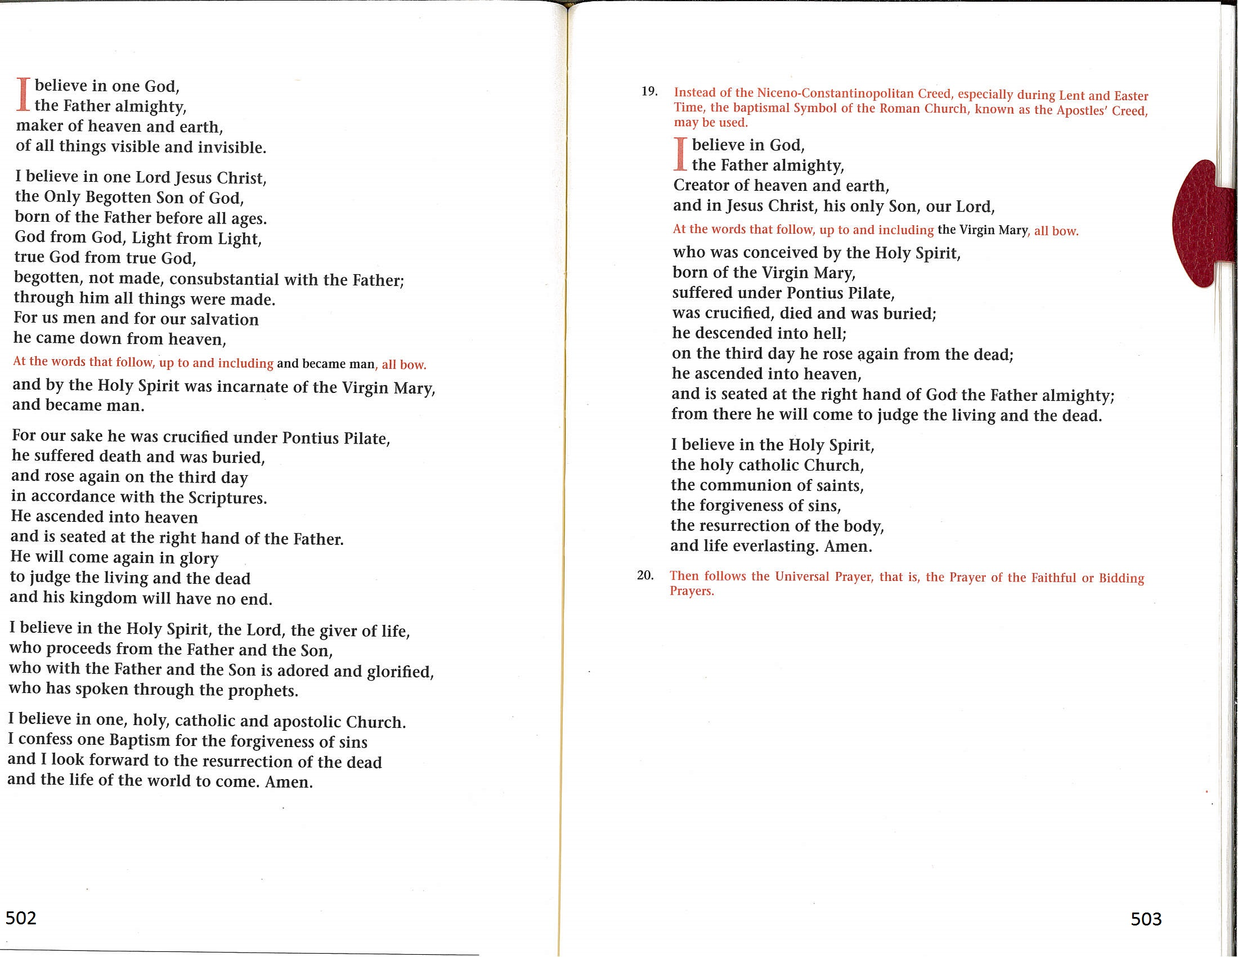
Roman Missal creed

Slide 35
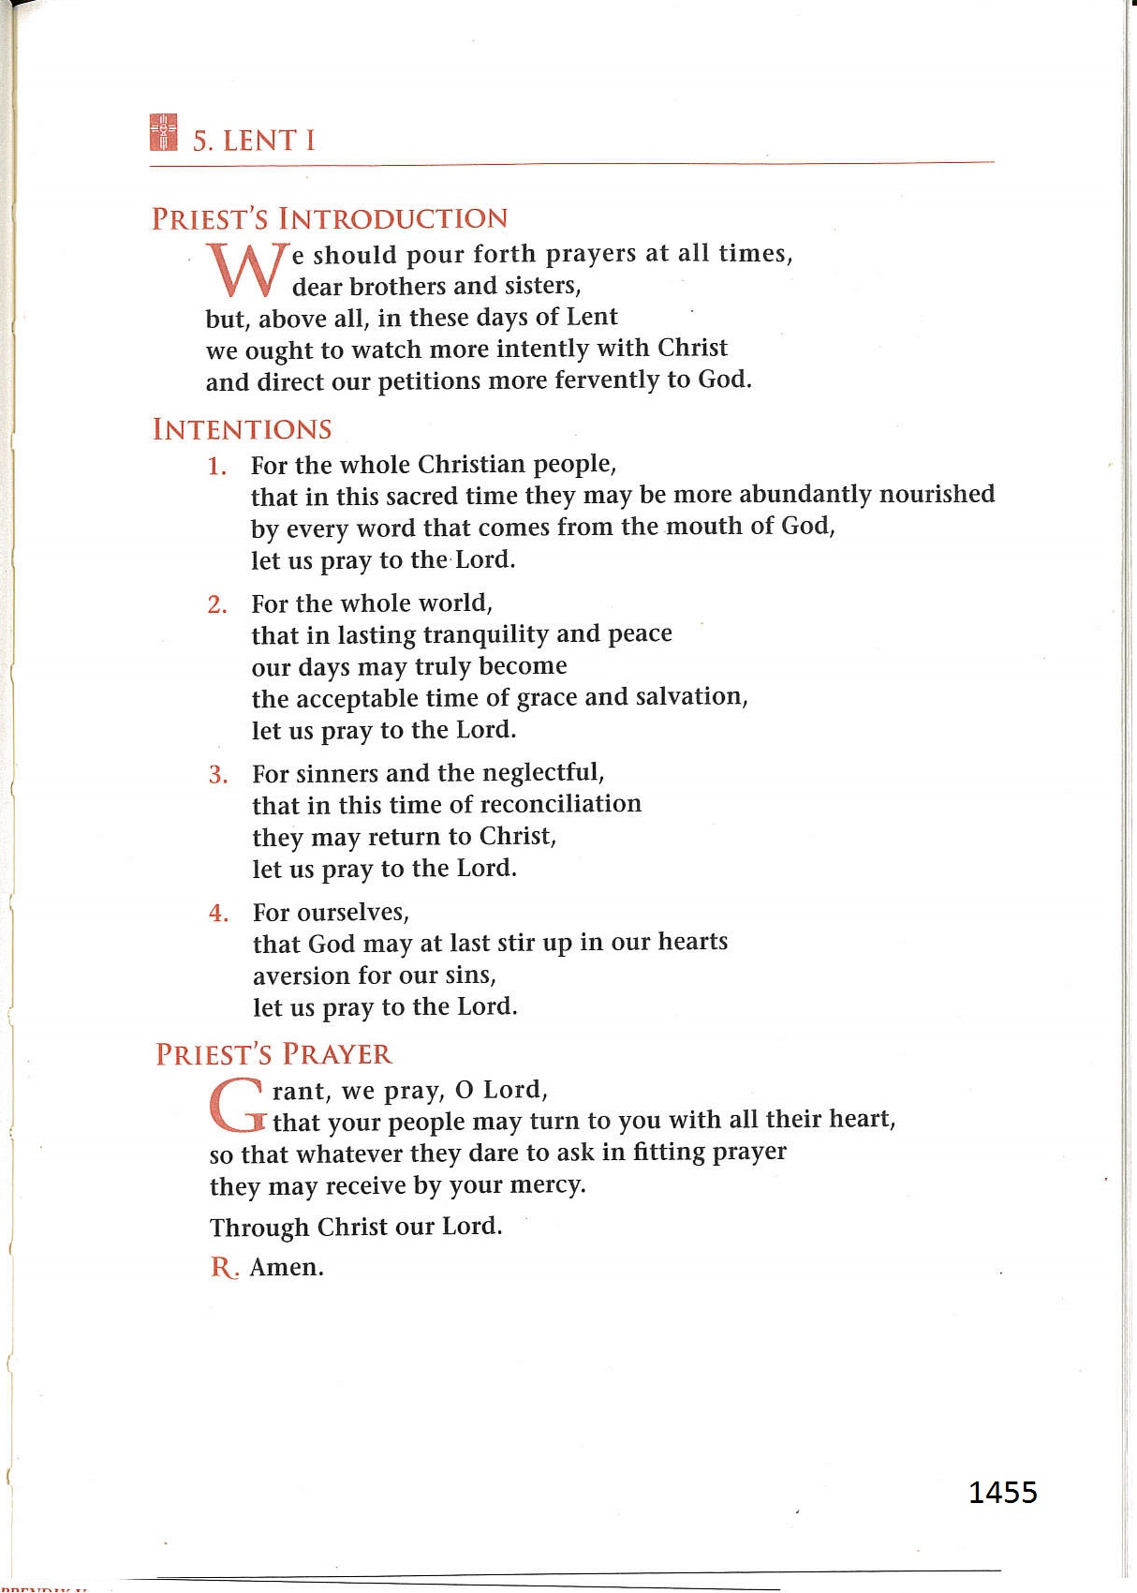
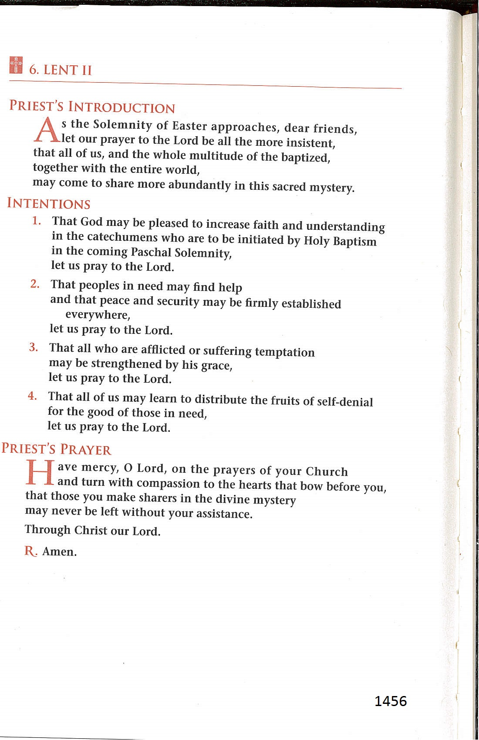
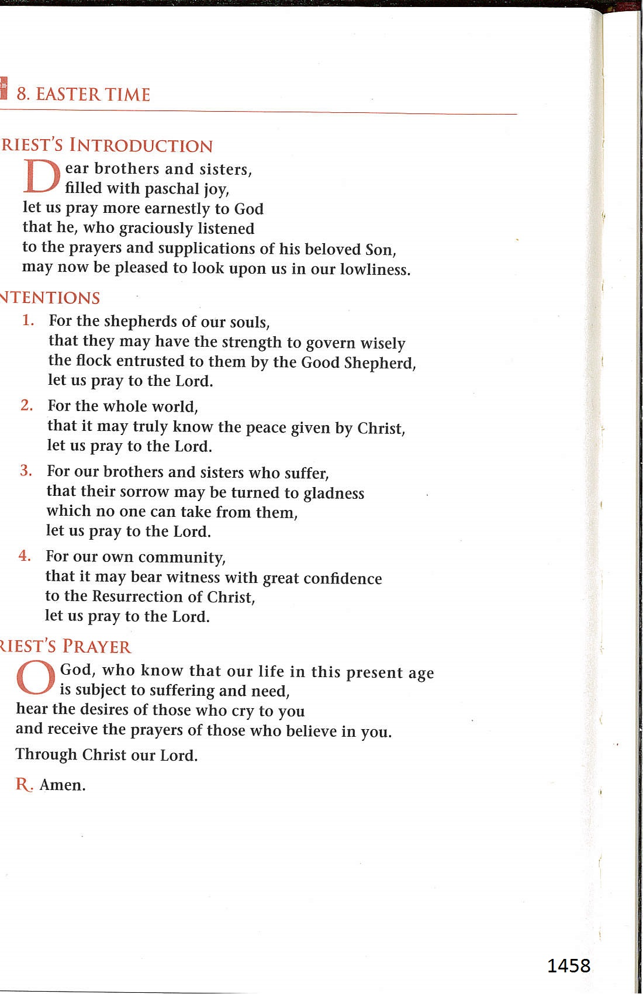
Roman Missal
Prayer of the Faithful

Slide 36
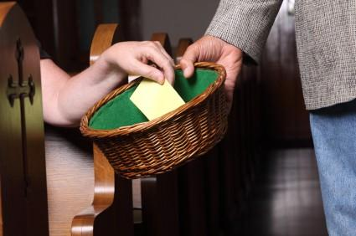
Roman Missal collection

Slide 37
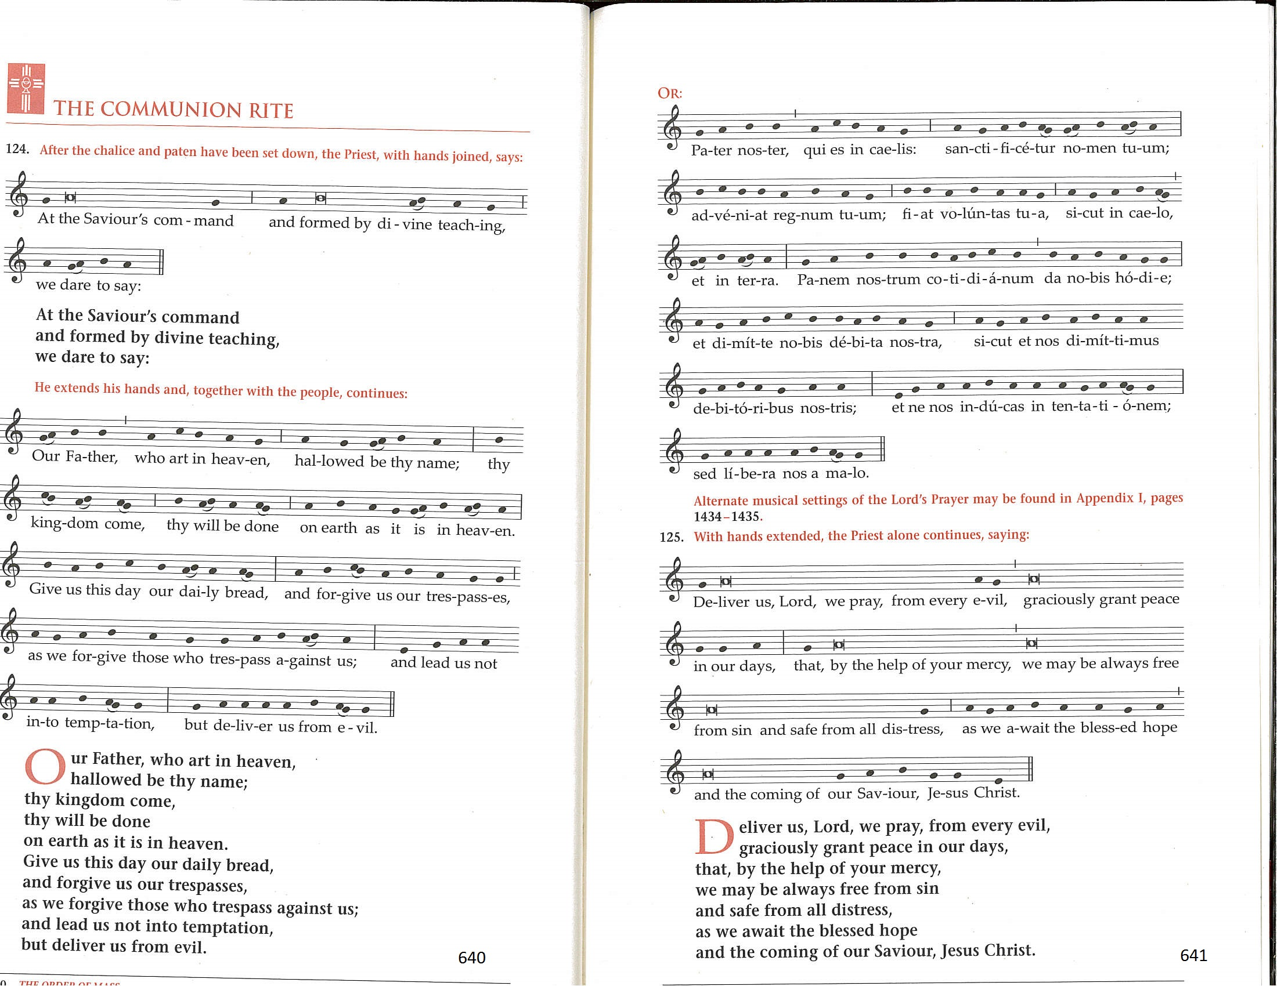
Roman Missal
The Lord’s
Prayer and “Deliver Us”
Remain at the chair

Slide 38
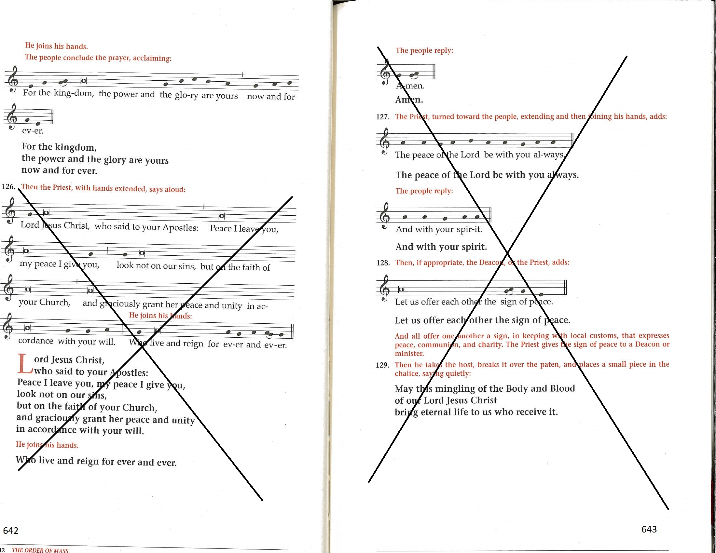
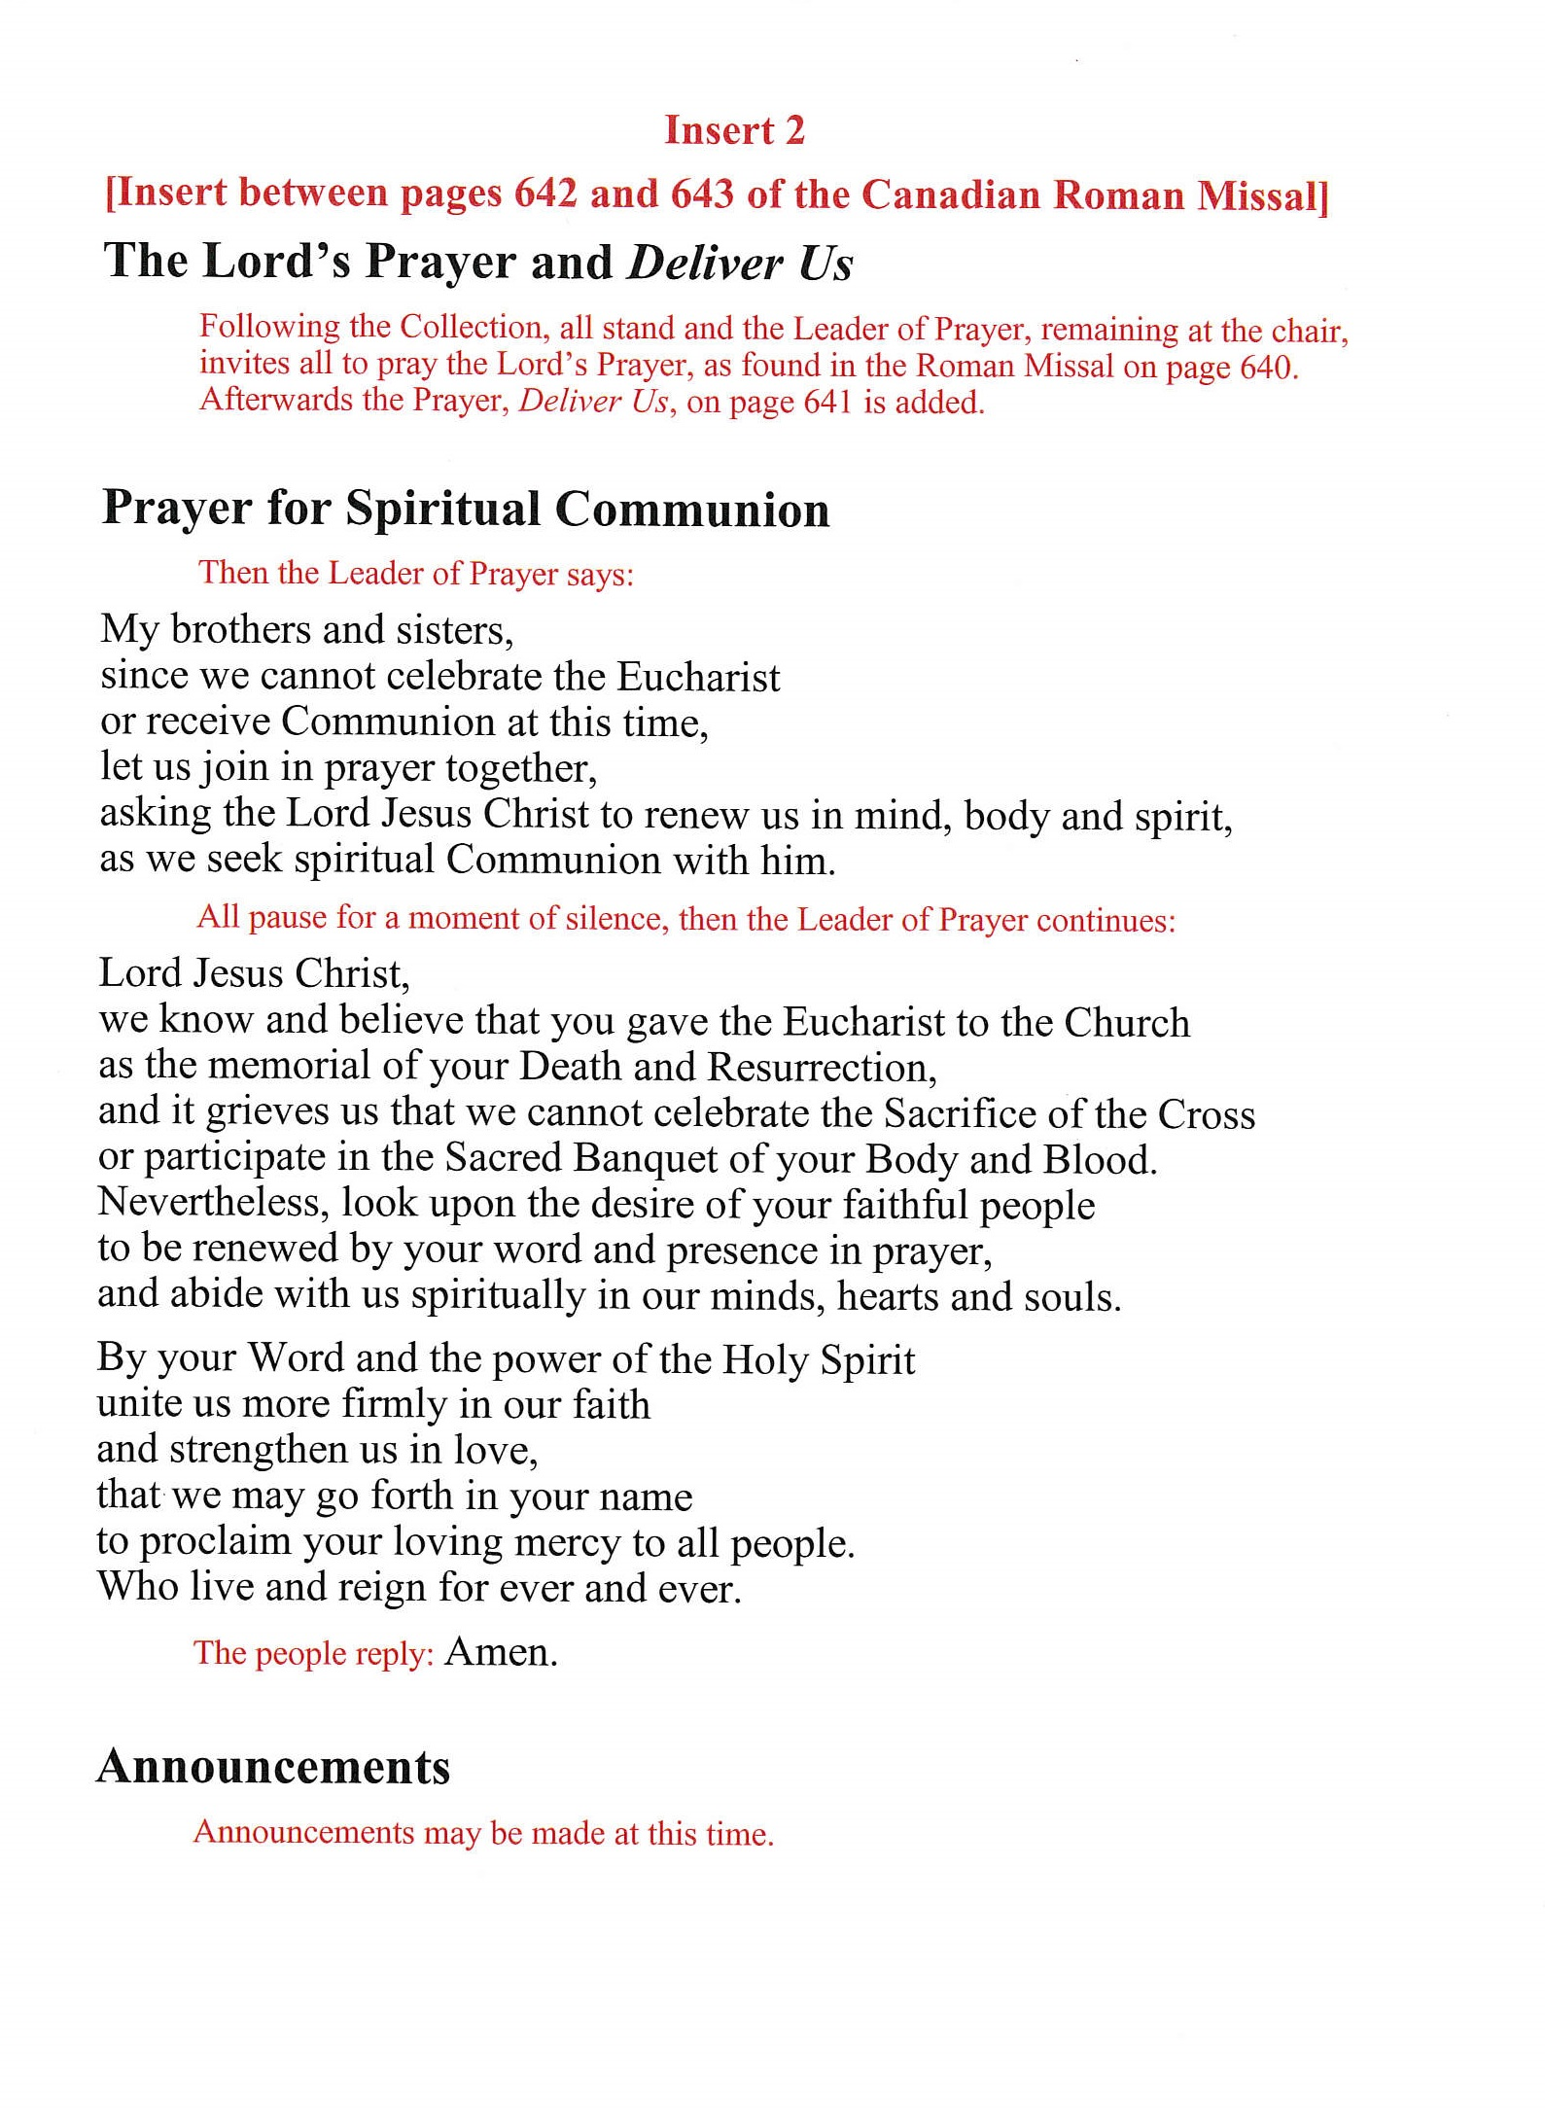
Roman Missal
Prayer for spiritual communion and blessing
Place insert 2 between pages 642 and 643

Slide 39
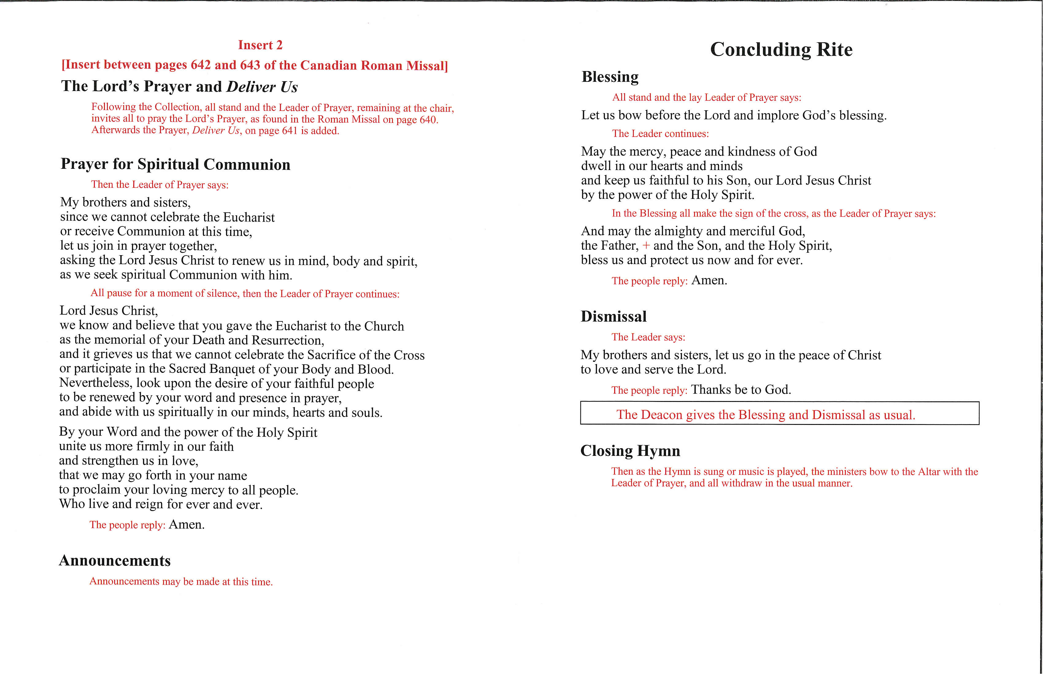
Roman Missal
Prayer for spiritual communion and blessing

